Slide 1
Deconstructing Contracts Training
Notes:
Welcome and Thank you for attending.
Email was sent earlier prior to the training with links, resources, and example documents that we will be covering. Please take a moment to grab your emails before we begin.

Slide 2
What is a Contract?
Contract: a legally binding written agreement where a supplier provides goods and/or services.
Examples include, but are not limited to:
  Quotes or proposals that have a signature line and terms of conditions
    Note: Terms and conditions may not be printed on the quote/proposal. The Supplier’s Form may have a hyperlink to terms and conditions.
  Statement of work, license agreement, MOU, etc.
  Addendum, Amendment or Renewal
Notes:
Clickable agreement to terms and conditions is a contract.

Slide 3
When do I need to do a contract?
If there are terms and conditions that require a signature, then its considered a contract.
  There isn’t a cost threshold (a common misconception). Contracts can be for zero dollars.
If there is a signature - Ask the supplier if they will waive the signature on contract and accept our Purchase Order
  By waiving the signature requirement, it can be processed as requisition/PO.
Notes:
PCard vs. Purchase Order vs. Contract
Pcard – if its under your Pcard limit, doesn’t require a signature, and isn’t a restricted Pcard purchase.
PO – doesn’t require a signature, or you have a signature waived
Contract – only needed if a signature is required. If a supplier is coming on campus, we require a contract is there is costing. Guest lecturers without cost do not require a contract.

Slide 4
Who Can Sign a Contract?
Procurement Contracts
  Contracts up to $40,000 are signed by the Chief Procurement Officer.
  Contracts Up to $500,000 are signed by the Vice President of Finance & Administration.
Academic Contracts
  Contracts up to $500,000 are signed by the Provost.
All contracts over $500,000 must be approved by Board of Regents and signed by the Chancellor and President.
Notes:
DocuSign contracts – watch out. Do not sign. Download only

Slide 5
TWU Signature Matrix
Procurement Contracts will be reviewed by the areas outlined in the TWU Contract Signature Matrix. This includes Procurement, IT Services (ITS), Risk Management, Digital Accessibility Information Resources, and Data Management. The Matrix outlines each contract category and which approvals it requires. This is signed off by Chancellor Feyten each Fiscal Year.
Notes:
Adding Data Accessibility and Data Management. Required for all Software / Hardware / Tech Comp contract. OGC reviews all agreements on supplier forms. Risk sees all except guest lecturers.

Slide 6
Purchasing Guidelines
Make sure the contract satisfies competitive bidding requirements
  Less than $20,000 – open market
  $20,001 - $40,000 – 3 quotes required, including HUB quotes
  Greater than $40,000 – formal solicitation facilitated by Purchasing
  Cooperative Purchasing Partner - Bidding requirements waived
  Sole Source – Only one supplier is capable of delivering the one product or service.
Notes:
Cooperatives – no cost thresholds (no formal bid, sole source, etc.) Sole source – can’t mention price in the reasoning. Must provide examples on number 6.

Slide 7
Contract Steps
Gather all documentation for contract package
  Contract, Risk Assessment, COI, Food Justification, VPAT/ACR/Exemption Form, HSP, 1295…
Make sure Supplier Set up in Cloud
Enter Contract Routing Request in TDX
  Answer completely and in detail all sections. This will determine routing.
Procurement will verify the package is complete and assign a contract number.
Enter Requisition in Oracle Cloud to secure funding for contract total
  Reference the assigned contract number when you enter your requisition.
Contract will then be routed through all required areas for approval.
  You may be requested to provide additional information/documentation.
You will be notified when Contract Routing has been completed and Procurement has sent the document for signature.
You will be notified when the Contract is fully executed.
  A copy of the fully executed agreement will go out with the PO to both the department and supplier.
Notes:
Once your contract number has been assigned by Procurement, you are free to put on your requisition. The only exception to this would be during the fiscal year changeover where you must wait till Sept 1st to put on your requisition with the new FY funding.

Slide 8
Contract Package
Supporting Documentation Breakdown
  What your contract package needs to contain for each contract type with links to templates and forms
Quote/Agreement/Order form - The document(s) that needs to be signed
Risk Assessment & TX-Ramp Certification - required for all software, licenses, web applications, or cloud services
  If you are unsure if you need a risk assessment for your contract, reach out to ITS.
Certificate of Insurance (COI) – required on all service contracts (except guest lecturers)
  If you are requesting a waiver of this insurance requirement, it must be approved by Risk Management.
Accessibility Compliance Report (ACR/VPAT) – required for all software, licenses, web applications, or cloud services
  If your supplier does not provide you a ACR/VPAT, you must submit a Accessibility Exemption Request form.
Food justification form – for contracts that contain any food
HUB subcontracting plan – for contracts over $100k if (if applicable)
Nepotism Disclosure Statement - for contracts $1M or more
Form 1295 - for contracts $1M or more
*** All signatures must be a wet signature or digital such as Adobe or Docusign.
Notes:
If you’re unsure of what type of contract you will be doing in order to grab the right documentation, check the contract category breakdown. It will let you know examples of each type of contract and if there is a template available.
All software/hardware agreements must be done on the supplier’s forms.

Slide 9
Contract Templates
Located on our Procurement Website – Forms & Instructions
These templates greatly expedite the review process and allows us to forgo legal review of agreements. We recommend that departments encourage vendors to accept our templates when applicable.
Templates must be submitted in Word format with all revisions tracked.
  The only exceptions to this are FMC contracts (Professional Services Agreements, Change Orders, Master A202, IDIQ PSA) and Performer/Artist Agreements.
Any edits made to an OGC approved template by the supplier or the department will require the contract to be submitted for legal review.
Notes:
When you get the fully executed contract, the contract will be a in PDF. When you submit, it needs to be in word with the revisions tracked. We need this to confirm that none of the previously approved OGC language hasn’t been edited. We will convert to PDF after we have processed and approved.

Slide 10
Available Templates
Amendment
Change Order (FMC)
Charter Bus Addendum
Conference Services
Guest Lecturer (in person)
Hotel Addendum
Media Artist Agreement
Master Services Agreement
Performer / Artist Agreement
Professional Services Agreement (FMC)
Psychiatry (CAPS/SHS)
Standard Form Agreement (FMC)
Virtual Guest Lecturer
Notes:
Change Orders, Professional Services Agreement, Standard Form Agreement – for Facilities only.

Slide 11
Most common templates
Guest Lecturer Agreement
  Speakers for a class or event
    In-person and virtual templates – make sure you grab the correct one!
Performer/Artist Agreement
  Entertainers coming on campus for an event
    Dancers, musicians, theatre troop
Master Services Agreement
  Independent contractor with specific detailed services
    Food trucks, party rental supplies, balloons, animal petting zoo, judging for a competition, sound & lighting
Media Artist Agreement
  illustrators, photographers, and writers
    Graduate school headshots, recording an event on campus
Notes:
Media Artist Agreement has an optional addendum for copyright language. If the supplier has issues with our template in regards to copyright, reach out to myself or Jenny and we can get that addendum with the options sent to the supplier to review.

Slide 12
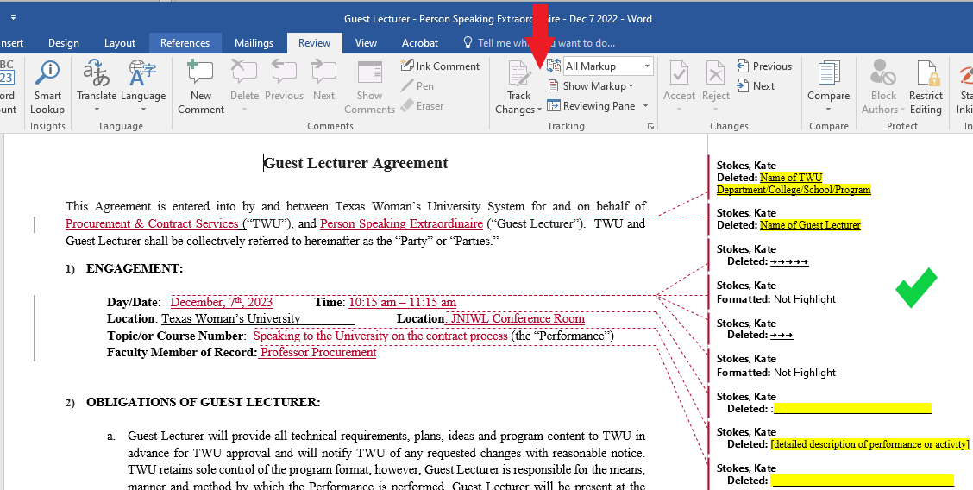
Revision Tracking
All TWU Templates and edits to Standard Contract Addendum must have revisions tracked.
Notes:
Needs to be done in Word, start to finish. If you open the agreement in Google Docs and then download to Word, the changes won’t be tracked. Same with PDF. If you fill it out in Word and then print to PDF and we tell you it needs to be done in word. You can’t just export over into word. You’ll need to start over.

Slide 13
Preparing a Template Contract
Highlights
  Areas to be completed by the department
    For example - Name of supplier, Compensation, Dates, etc.
Red text instructions
  Templates contain multiple provision options (choose your own adventure/contract)
    Choose one option and then delete the other
University Contact Name
  For all notices and communication.
    This should be someone in your department
Please remove all highlights and red text instructions before uploading your contract for review. This greatly saves us time.
Notes:
Side note – if you have a supplier form that has highlights on it, it is super helpful if you reach back out to them to remove those. Specifically with PDFs. It is very time consuming and a pain to remove highlights from PDFs. Especially those that are scanned in. Please and thank you.

Slide 14
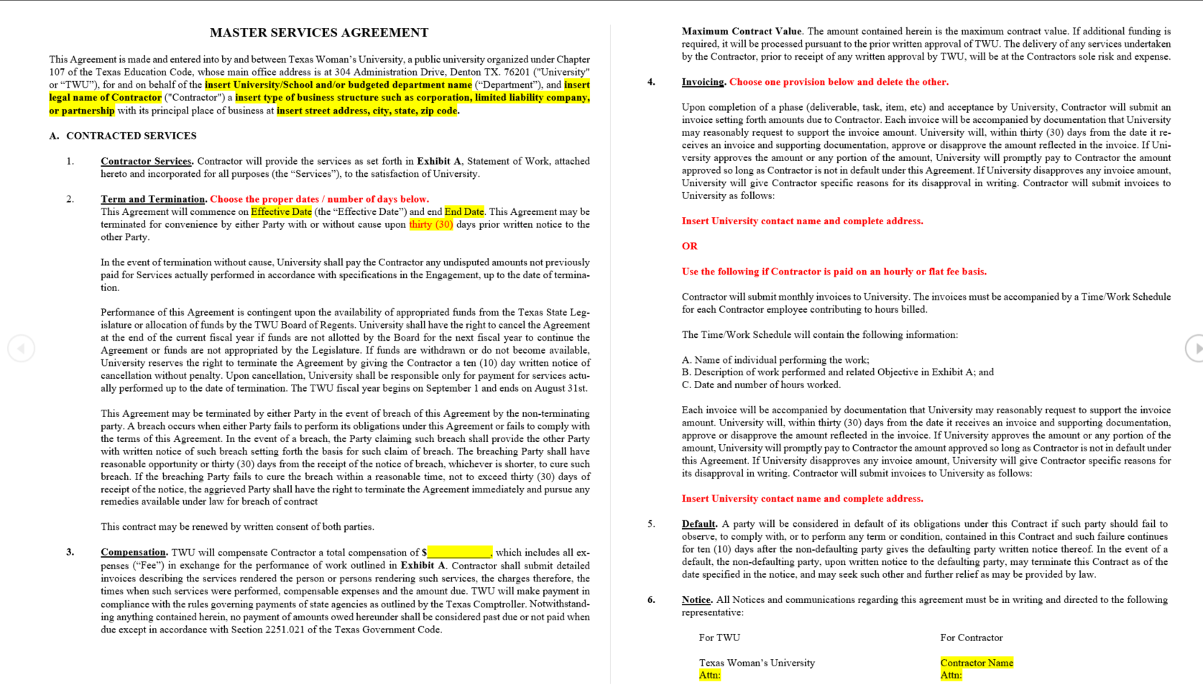
Master Services Agreement - MSA
Notes:
Probably the most common request for help is with our MSA. We’re going to dig into this and give you all a heads up guide. The areas you need to worry about: highlights and red text. Anything else… disregard. We’re going to focus on that information and make this easy. You should have a blank MSA template in the email that was sent prior to this training. If you do not, you can go to our forms and instructions page to reference one. And if you don’t know where that is, you can find it on the landing page.

Slide 15
MSA - Breakdown
University/School and/or budgeted department name
Department paying for the contract
Legal name of Contractor
The supplier’s business name (or DBA)
  Find this on the supplier’s W9 (number 2)
Type of business structure such as corporation, limited liability company, or partnership
The suppliers federal tax classification
  Find this on the supplier’s W9 (number 3)
Effective date & end date
Term of the agreement – starting and end
Compensation
How much we will be paying the supplier
Notice
For all communications, address and contact name
  Supplier information must match address on W9 (number 5)
Notes:
See the example of the W9 that was sent to you via email. This will help as a guide for some of these.

Slide 16
Choose your own adventure/contract
4. Invoicing
For lump sum payments for completion of services
For contracts where the supplier will be paid hourly.
8. Ownership and Use of Work Material
TWU gets ownership of all deliverables and materials.
Supplier maintains ownership of all materials.
For each, choose one option and delete the other.
Notes:
Our MSA can cover a wide variety of services. These two steps allow us to mold the agreement to the specific service we’re wanting.

Slide 17
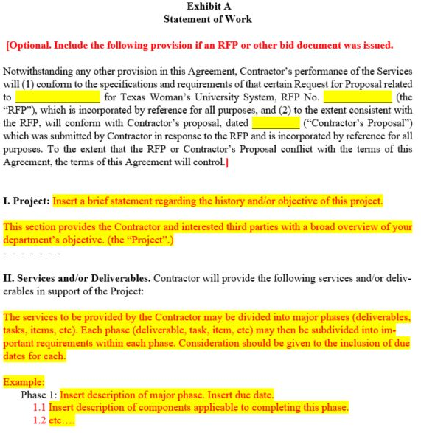
Exhibit A
RFP – For listing formal bid information.
  Project
  RFP#
  Date of proposal
    If you did not do a formal bid, delete the section
Project
  Brief overview of details
    Project name / event name
    Date of event
Services and/or Deliverables
  Detailed description of all services or deliverables that we want the supplier to provide
Notes:
Give a food truck example. Who what where why

Slide 18
Preparing a Supplier Form Contract
Read the contract
It is the responsibility of the department to understand what you’re purchasing
This includes:
  Purchasing guidelines and bid limits
  Payment terms and cost
  Renewal Term and expiration
    Set reminders on your calendar that way you can plan ahead for routing and processing
REMEMBER!
This is YOUR contract. Procurement reviews for State of Texas Purchasing rules/laws and legal only reviews legal terms. We do not review the contract to determine if it is a good contract for department.
You are responsible for the management of the contract and keeping up with the renewals
Notes:
Reading over a contract is overwhelming and intimidating. These three areas are what you need to focus on. Commonly we hear “how am I supposed to know the contract number” or “how am I supposed to know when a contract expires or if it renews”… this is your contract you are committing the university to. It is your responsibility to keep track of that. We’re happy to assist if you’re having difficulty but it is not our responsibility to make sure you are being responsible with your agreements and keeping track of renewals and terms.

Slide 19
Legal Review
Office of General Counsel (OGC) is required to review:
  Agreements that are on Supplier Forms
  Agreements that have proposed edits to our TWU Templates.
Standard Contract Addendum – Contains mandatory Certifications we are required to have on all our Agreements per Texas Legislature.
If Vendor won’t accept any of our clauses (Addendum) or any of our redlines to their agreement Legal will deem non-compliant and will not sign off on contract.
Office of General Counsel is in charge of all legal negotiation communications. This includes sending the Standard Contract Addendum for review prior to contract routing and after the ticket is submitted to OGC for legal review.
Notes:
Overview of process
when you submit your ticket, we in procurement make sure we have all the supporting documentation and the ticket is filled out correctly.
Once the routing is complete in our system, the contract is submitted to OGC for legal review.
You will be notified when the ticket is submitted
We’ve recently added OGC into our ticketing system.
Legal negotiations will be communicated via email.
Whomever submitted the contract, the contract manager, and account approver will be included on any communications with the supplier.
When we have an agreement of terms, OGC will create the final forms.
Procurement will send out for signature.

Slide 20
Processing timeline
Please allow at least 3 – 4 weeks for Procurement to process a contract on a template.
  This time line starts from when the contract package has been approved by procurement
  This does not include time for Risk Assessment. This is to be completed prior to submitting your contract package.
Contracts that require legal review will take an ADDITIONAL 2-4 MONTHS for review.
Submitting contracts without proper processing time causes delays in other areas.
SO PLEASE PLAN AHEAD……
Notes:
Aside from the Risk Assessment, all routing goes through our TDX System now. So its really important to get the process started as soon as possible. The sooner the better. There is never an issue with getting contracts signed in advance. We recommend it.

Slide 21
Common issues
Contract Package submitted Incomplete or Missing documentation
  Incomplete contract packages will not be processed
The contract must be submitted in Word when using a TWU template.
  The only exception is the newly updated Performer/Artist template.
Tickets entered with incorrect information will be rejected.
  Incorrect information will not allow your contract to be routed through the proper channels.
Not a service selected
  Unless the contract is for a good, then it is considered a service.
  Software is considered a service not a good
Double check your information before submitting to make sure its correct.
Notes:
Double check your responses on the ticket. Once you enter it, you cannot edit. What you enter affects the routing. If there are errors, we will have to reject and you will have to enter a new ticket. We have to do this to make sure all appropriate areas are included in the routing workflow.

Slide 22
Common issues continued
Expired Contracts submitted for review
  Expired contracts cannot be processed.
  If the term date has passed please have the vendor adjust the contract start date to a current/future date (Keep in mind the time it takes to process).
  Things to look for:
    Sign by date
    Quote good for 30 days
    Agreement is valid until..
Incorrect account string / account approver
  Make sure you’re selecting the correct approver for the string listed. This will affect approval routing.
  If using Grant or Capital Project funds, please provide the correct Oracle Cloud SPN.
New Chart Strings & Account Approvers
Notes:
If you are using the supplier’s forms for the agreement, please make sure to ask the supplier to cast out far enough for legal review. Many times quotes are submitted that will expire within a couple of weeks sometimes shorter.
Double check your account approver for the new chart strings. The amount of approvers were significantly trimmed down so double check. We’re happy add people onto tickets that need to be informed and updated, but the account approver is non-negotiable. It has to match what is on the crosswalk.

Slide 23
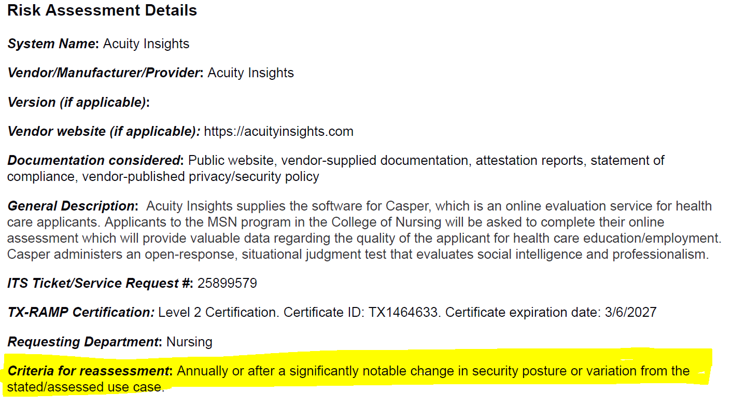
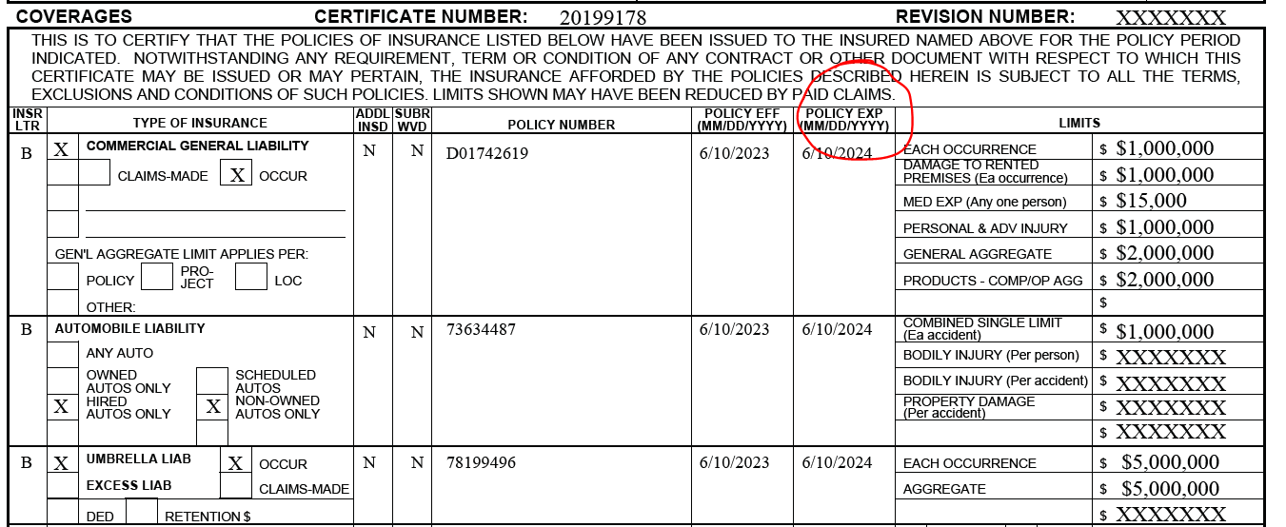
Common issues continued
Supporting Documentation is expired
  Risk Assessment
    Check your criteria for reassessment. This is usually listed on PG 2 under Risk Assessment details.
  Certificate of Insurance
    Check the expiration dates provided on the ACCORD form.
Notes:
This is the most common delay in contract processing. When submitting your contract package, you need to make sure that all supporting documentation is viable and not expired. With the Risk Assessment, you can find this information under Risk Assessment Details (usually on PG 2). It will clearly state annually (every year) or biannually (every two years). Check this in relation to the date in which the Risk Assessment was signed. If the Risk Assessment is set to expire prior to the start date of the contract, you will need to process another Risk Assessment prior to us processing the contract.

Slide 24
Notifications going to Junk/Spam
For Windows PC:
Open Outlook and navigate to "File."
Select "Manage Rules & Alerts."
Ensure that TDX is on the approved whitelist.
Check the box next to any rule that might be impacting email routing.
Click "Change Rule," choose the type of change needed, and follow the on-screen instructions.
For Mac:
Click on "Home" in the upper left corner.
Locate and click on the "Rules" icon.
Choose "Edit Rules" under the "Rules" icon.
Confirm TDX is on the approved whitelist.
Follow the on-screen instructions to add, edit, or delete Outlook email rules.
If users encounter any challenges or if the issue persists, I encourage them to reach out to the service desk for guidance (940) 898-3971. They are equipped to provide additional assistance and ensure a smooth resolution.
Notes:
If your account approver hasn’t approved your routing, make sure their notifications are going to the right place.

Slide 25
Contract Routing Ticket System
This new system will allow for review of contracts to happen in an open workspace and will replace the Contract Routing Sheet. This should greatly reduce processing time and create transparency for the front end users.
https://servicecenter.twu.edu/TDClient/1956/Portal/Requests/ServiceDet?ID=53850
Notes:
Save this Link!

Slide 26
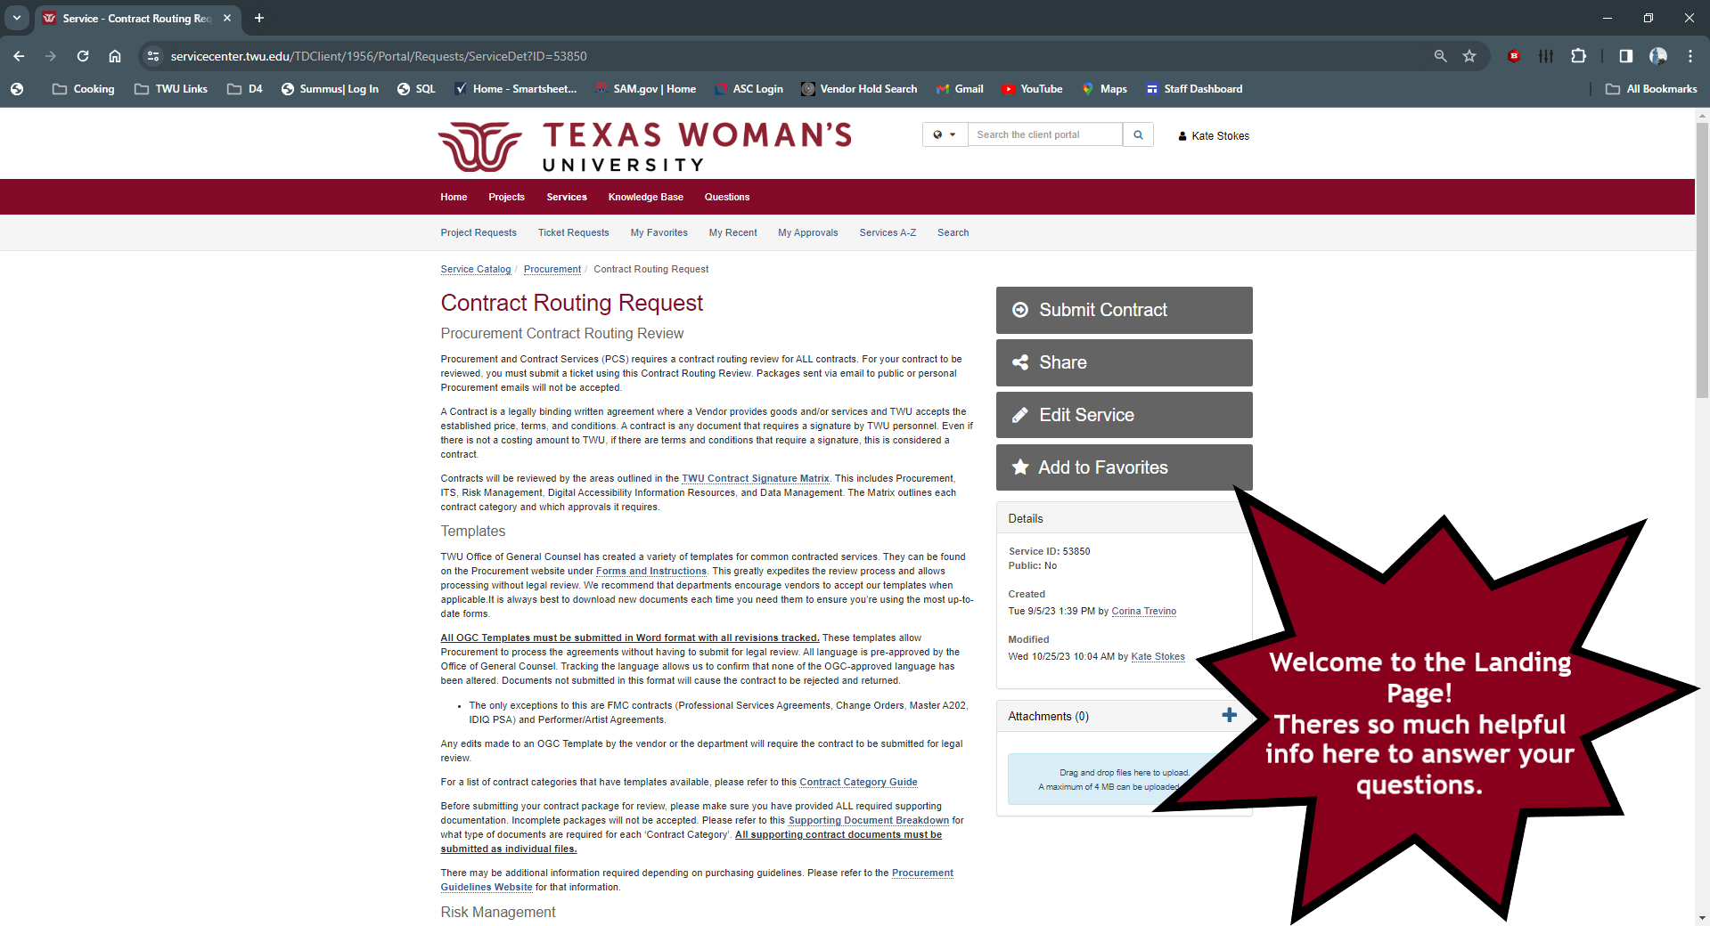
Welcome to the Landing Page!
There is a lot of helpful information here that will answer many of your questions. Hyperlinks are in blue. They contain documents and links to other internal TWU Areas involved in the Contract Routing Process.
Notes:
This is a one stop shop for contracts. Don’t have to go searching for different information. Links are embedded on the page that take you directly to what you need – even forms to download and other ticketing systems.

Slide 27
Landing Page Information & Resources
TWU Contract Signature Matrix
  Shows who will be required to review the contract & who can sign the contract
Forms & Instructions
  TWU OGC Approved Templates & forms for documentation
Contract Category Guide
  Examples of contract types and if there is an approved template
Supporting Documentation Breakdown
  What your contract package needs to contain for each contract type with links to templates and forms
Third Party Insurance Standards
  What Risk Management will be looking for on the COI
ITS Risk Assessment Ticketing
  ITS Risk Assessment is done outside of our system.
Notes:
Third party insurance standards – don’t just ask the supplier for their COI. Make sure you’re requesting what we need. Almost all the COIs that come in, need correction.

Slide 28
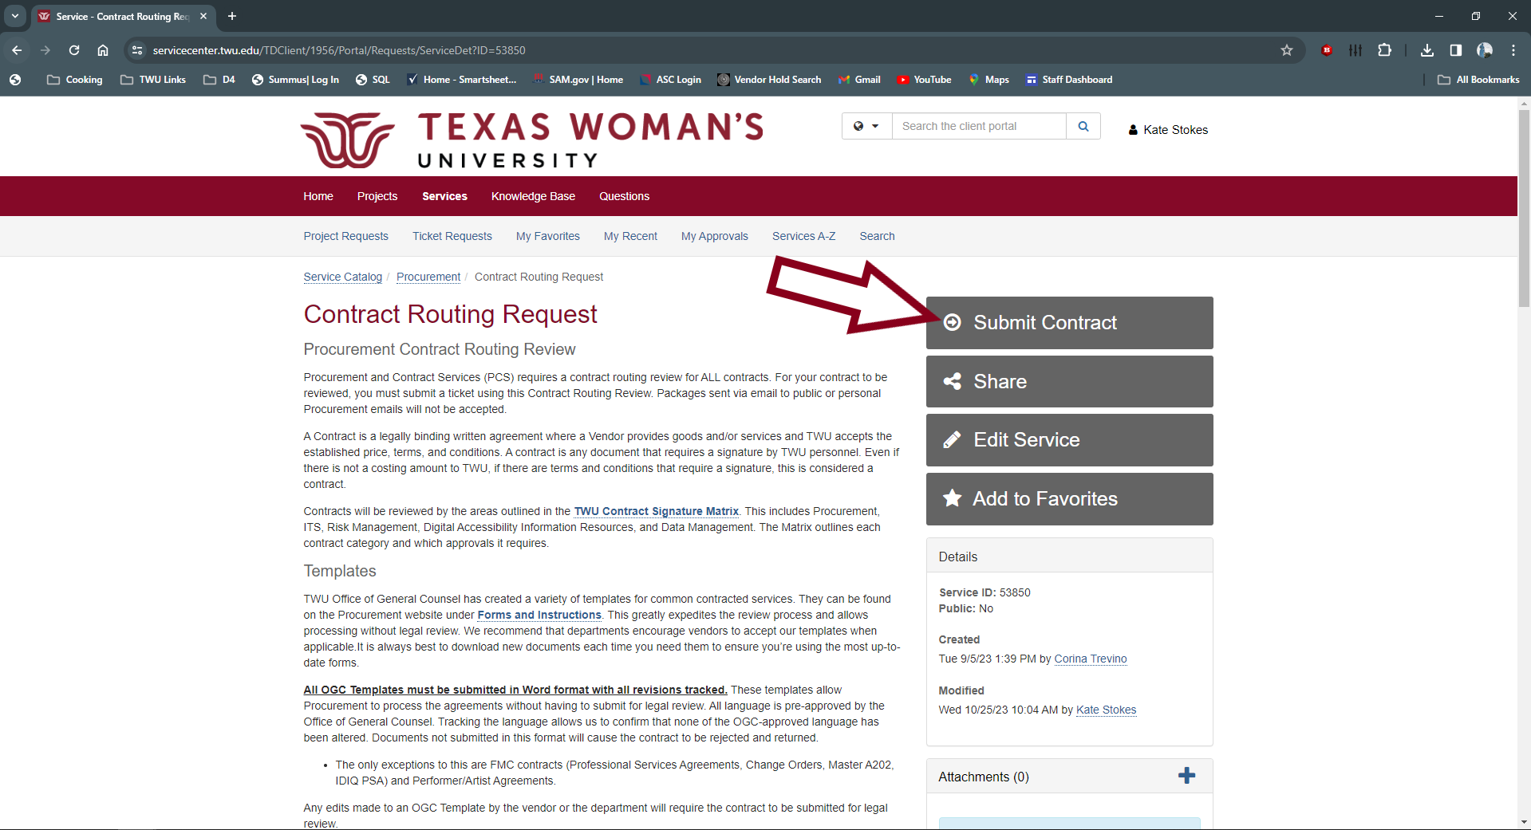
Creating a Contract Routing Ticket
Click on Submit Contract
Notes:
Contracts can only be submitted via this TDX Routing. If you’ve reached out to us via email regarding a question, you still will need to submit your contract via the ticketing system. Packages / package pieces will not be accepted via email. Everything must go through this system. Questions regarding your contracts already in routing should also be posed within your ticket to keep track of communications.

Slide 29
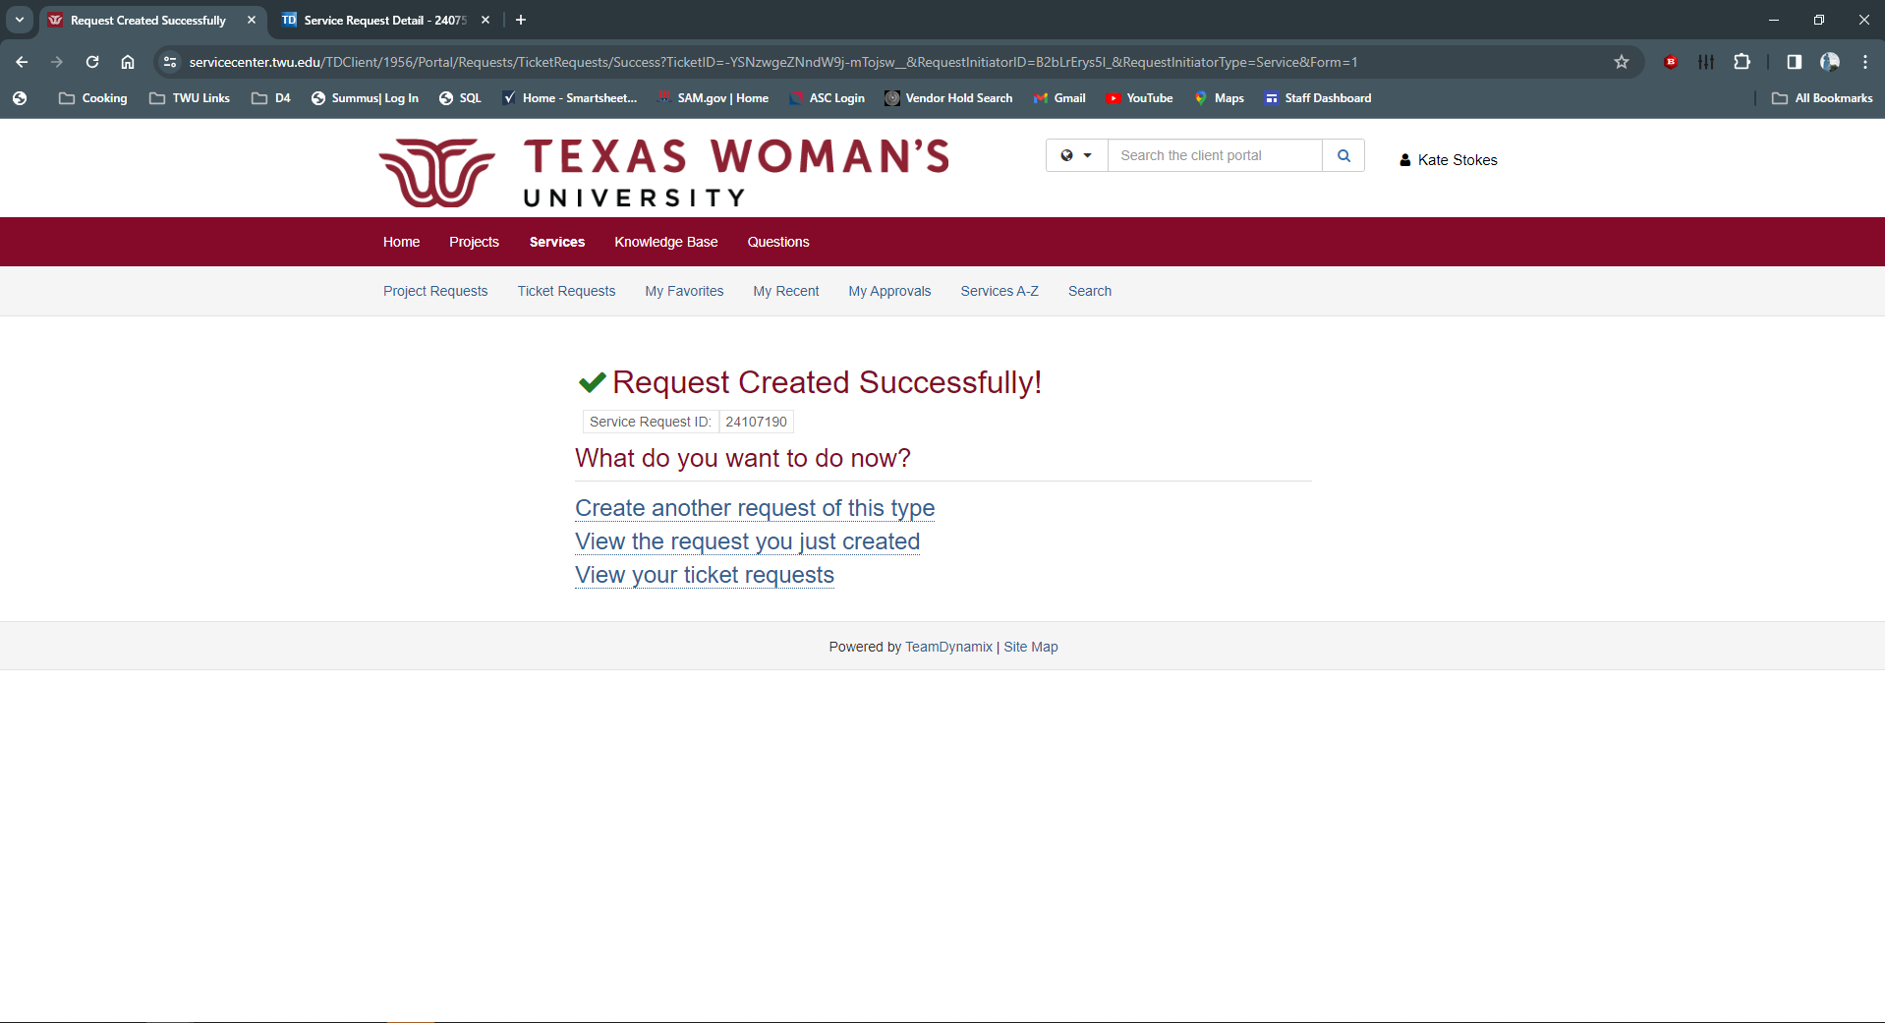
Ticket Confirmation Screen
You will get a confirmation screen if your ticket was submitted correctly. Keep track of your ticket number incase you need it.
Notes:
Keep track of your ticket number. If you lose the email with the link to access, you can search in the service center with this ticket number.

Slide 30
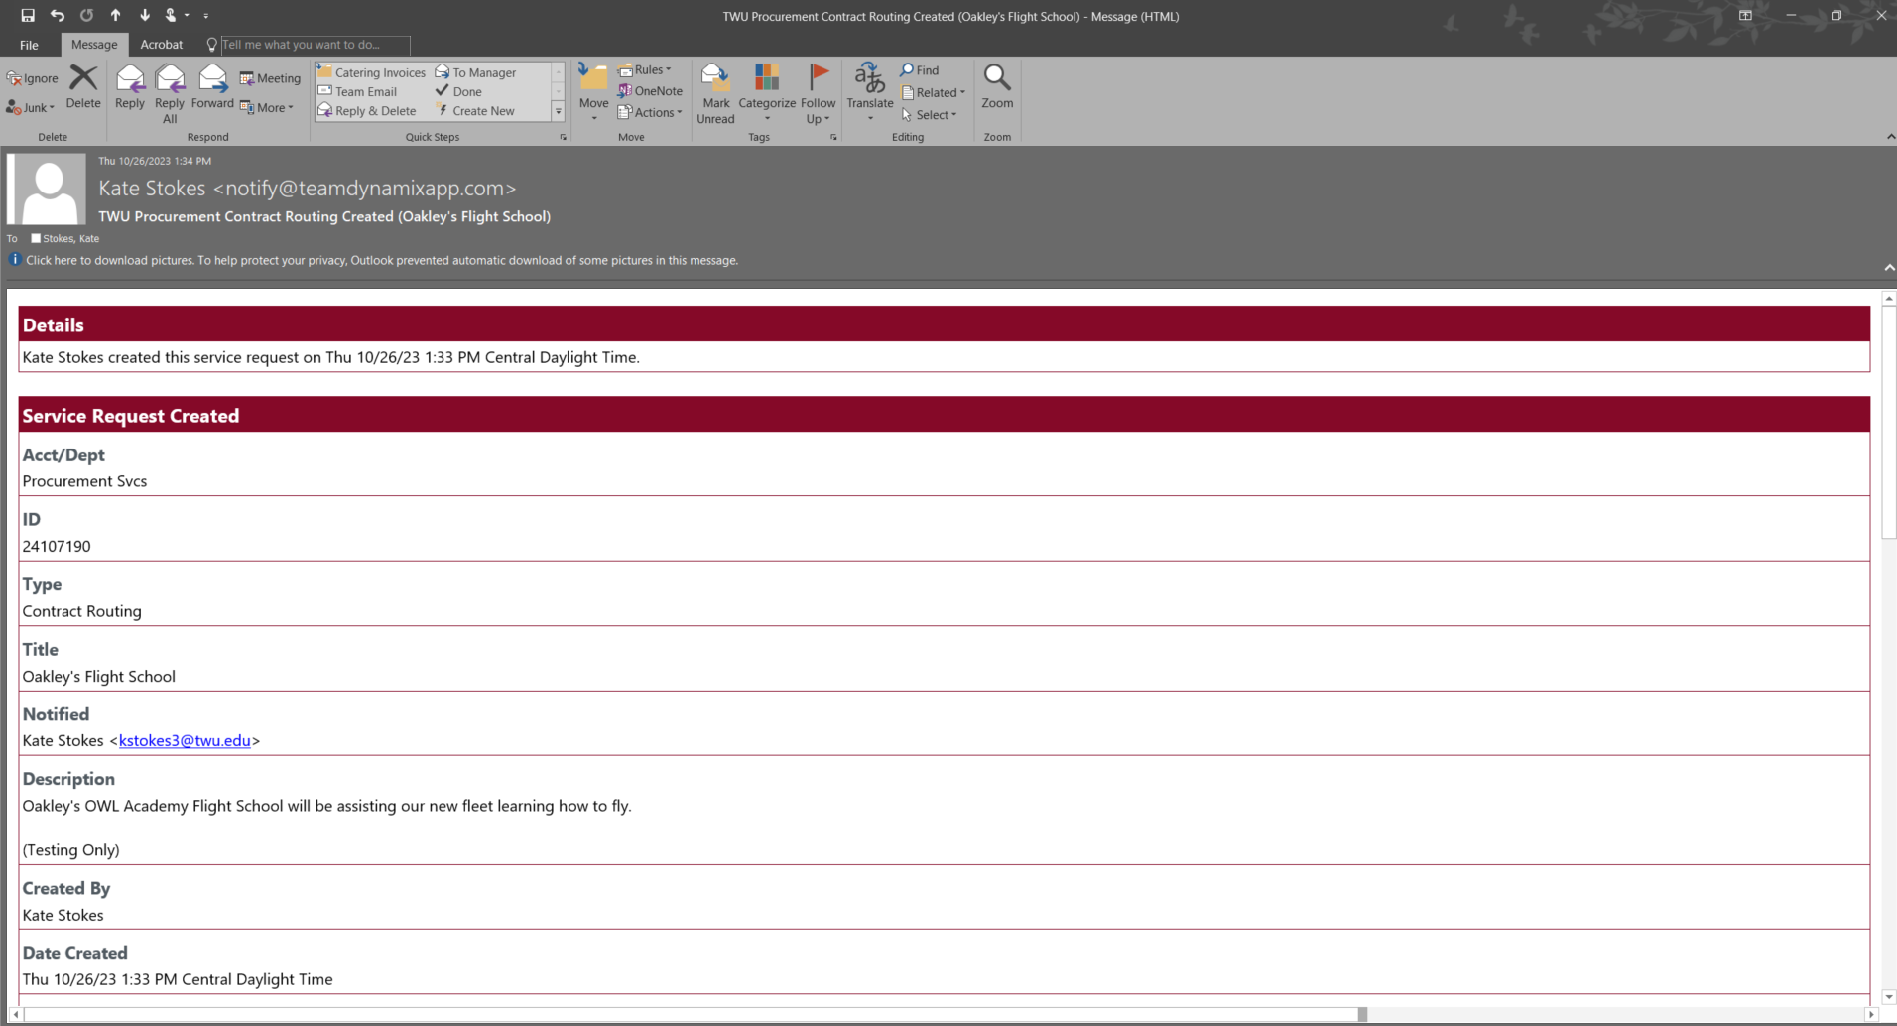
Confirmation Email
You will also get an email confirmation when your contract has been submitted correctly.
Notes:
Recommend creating a folder in your outlook where you can stash this confirmation email message. This message contains a quick link to access your ticket. Highly recommend saving. Super helpful.

Slide 31
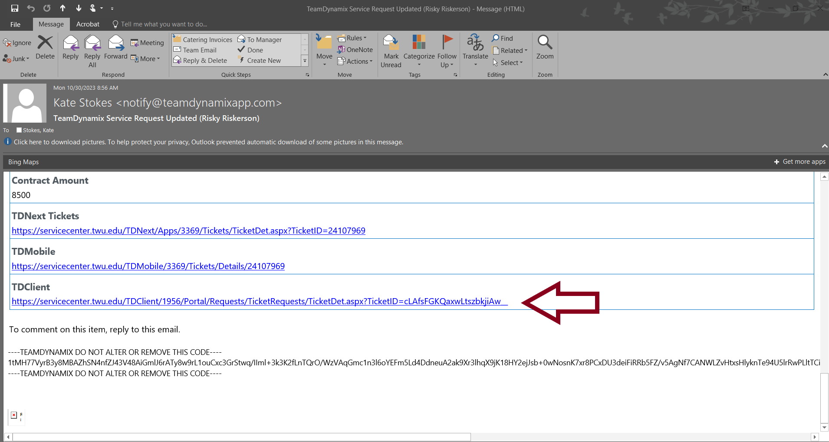
Link to TeamDynamix Ticket
You can access your ticket by clicking on the link located in the confirmation email. This is super helpful and worth saving.
Notes:
You can only access your ticket via the TDClient link. The other links you will get a you shall not pass from Gandalf on that.

Slide 32
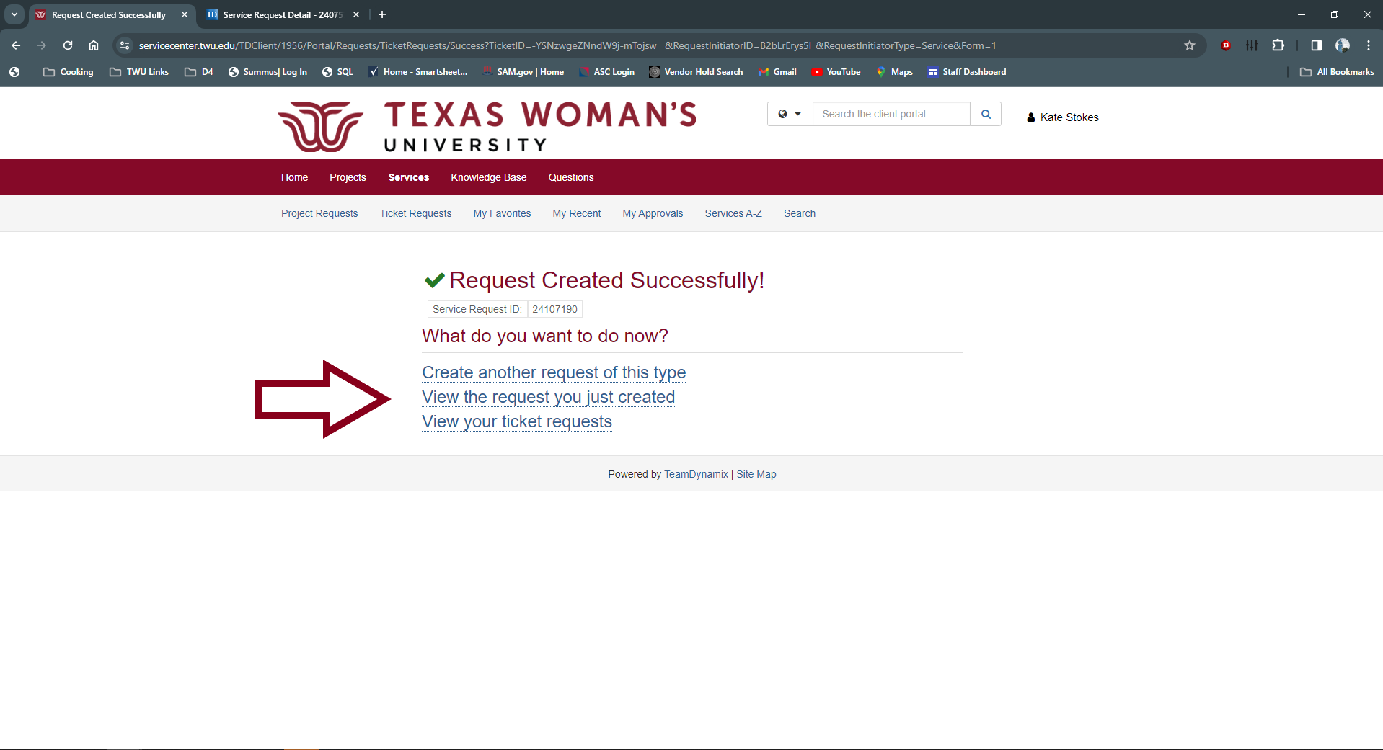
Add Supporting Documentation
To add the rest of your Supporting Documentation, click on “View the request you just created”
Notes:
When you enter in your ticket, you should have all the pieces of the package ready to go. I recommend going in immediately via this link and upload the rest of your supporting documentation. This way there isn’t a delay in the review. Jenny and I are very quick to pick things up and work on them.

Slide 33
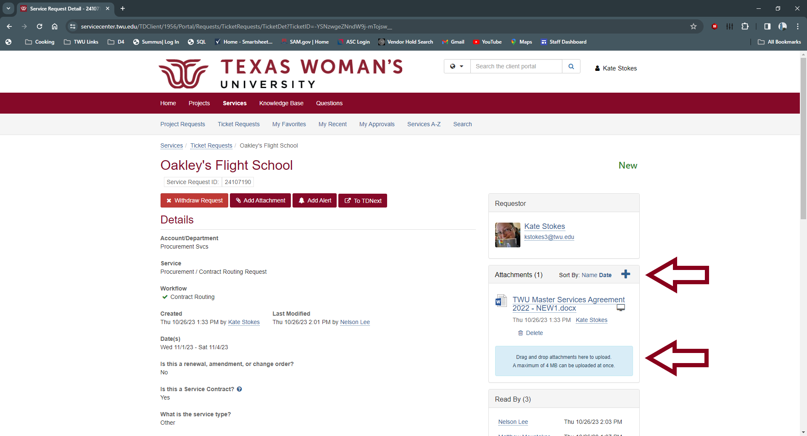
Adding documents to ticket
You can add the rest of your supporting documentation here. You can add documents by clicking the ‘+’ or by dragging and dropping to the Attachments Section on the right. We recommend clicking ‘+’ for larger documents.
Notes:
Drag and drop has a limit of 4mbs. Adding via ‘+’ has a limit of 50 mbs. You can also upload directly from your computer, google drive, dropbox, and OneDrive.

Slide 34
Naming of Documents
Keep it clean simple and informative.
  For Example:
    Contract – Supplier Name
    Guest Lecturer Agreement – Supplier Name – Date of Event
    Name of Supplier – Project Name – Project Number
    Risk Assessment – Supplier Name
    1295 – Supplier Name
  What not to send in
    124356785u6ytrewdfsgh.pdf
    This_Name_is_so_long_its_going_to_break_my_hard_drive_when_I_try_to_save_this….
    Untitled1.doc
Each piece needs to be uploaded separately. Do not send in one giant file will all your documents. Your ticket will be returned.
Notes:
Keeping things clear and concise helps all parties reviewing. Please title your documents clearly.

Slide 35
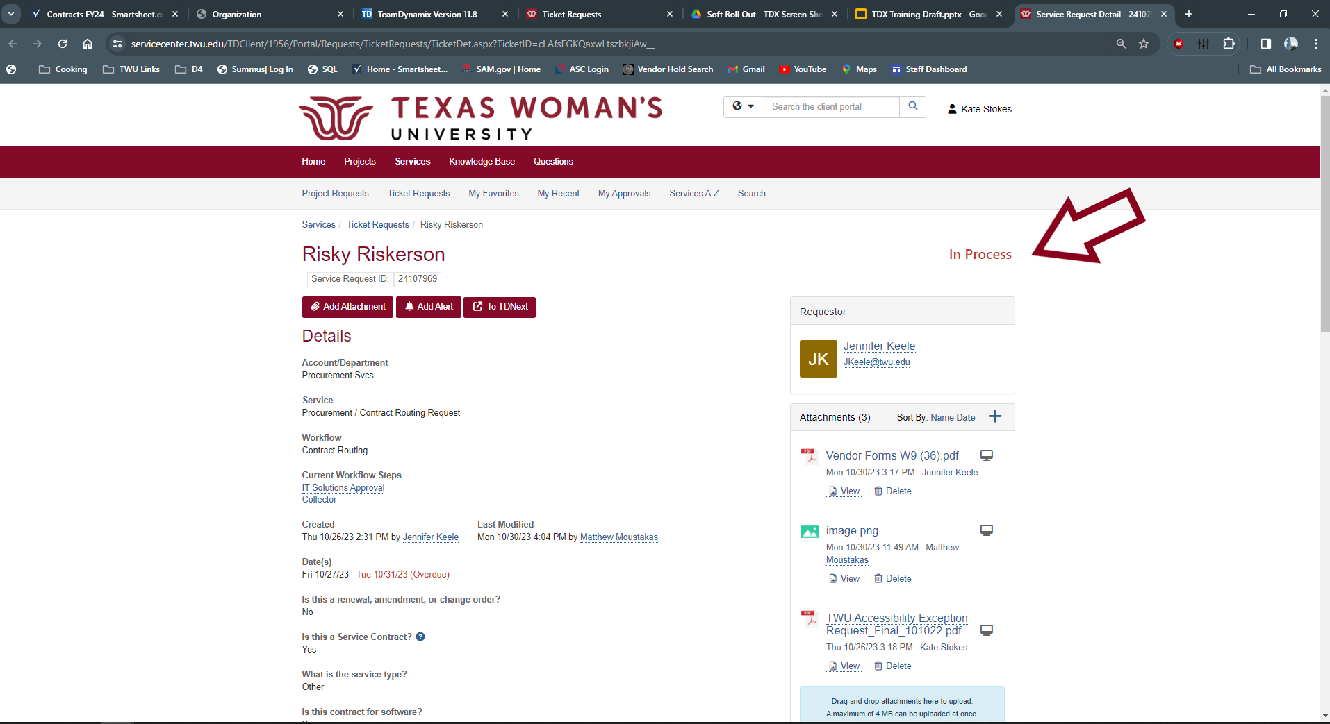
Ticket Status
Here you can see the status of your ticket. This status will be updated through the contract routing process

Slide 36
Statuses
New
  Status of a new agreement entered into the ticketing system. This means it is still being reviewed and approved by Procurement.
On Hold – Department Correction Required
  If correction to documentation or question is asked by Procurement to the department.
In Process
  Procurement has approved the agreement and has routed to other TWU areas for review and approval.
Contract Routing Complete
  The contract and all supporting documentation has been reviewed and approved. The contract is being sent out for signature.
Closed
  The contract has been fully executed.
Contract Package Not Accepted – Correct and Resubmit
  Contract package is has not been accepted by Procurement. This could be due to a number of factors. Review the corrections provided and resubmit your ticket with the requested corrections.

Slide 37
Statuses Continued
Sent for Legal Review
  Contract has been submitted for legal review.
Legal Review – OGC Reviewing
  Contract and/or edits are being reviewed by TWU’s Office of General Counsel.
Legal Review – Supplier Reviewing
  Proposed edits and terms are being reviewed by the Supplier.
Legal Review – Pending Department Response
  Office of General Counsel has questions for the department. Please answer them for the review to continue.

Slide 38
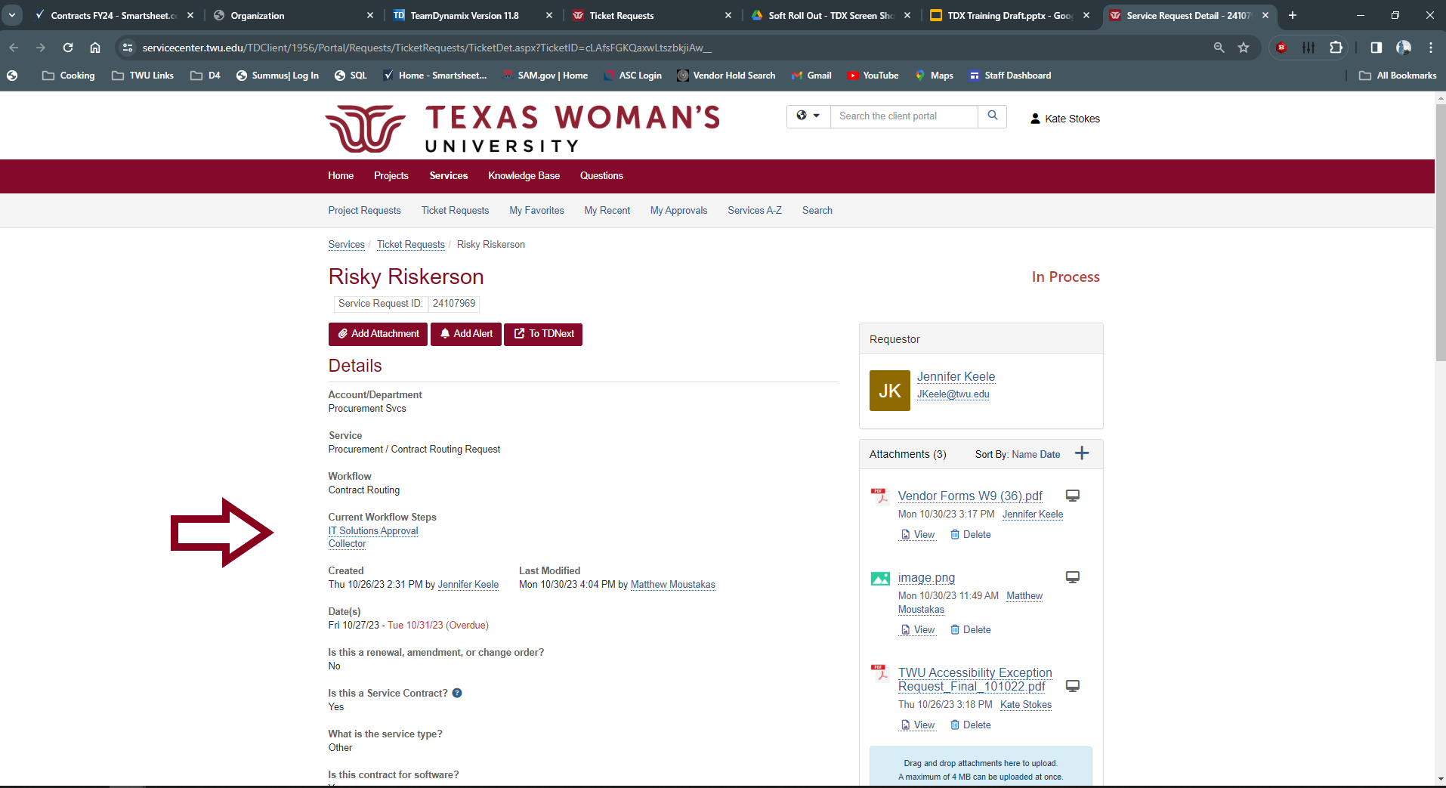
Workflow Steps
This will show you what area will be reviewing your agreement and where it is in the review process.

Slide 39
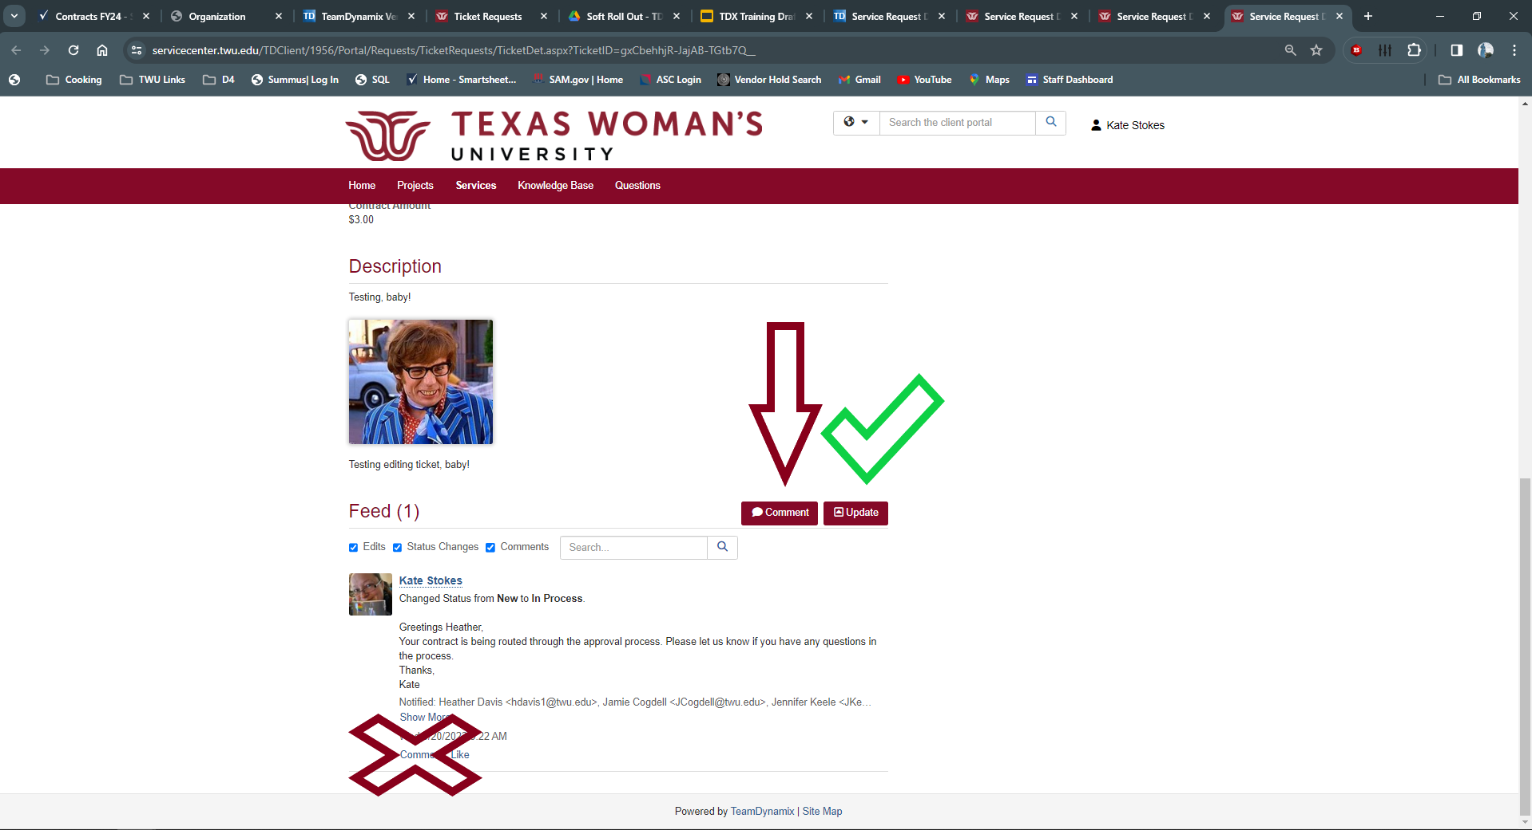
Adding comments and uploading documents
It is extremely important to notify approvers when you make a comment or upload documents to the ticket. To make a comment and notify your approver, use the comment button. Do not comment directly to another comment. There isn’t a notify option.
Notes:
This is the most common error that we’re seeing. It is very important to make sure that when you upload a document that you notify us. You can’t just drag, drop, and move on. If you don’t notify us, we don’t know that you did it. Luckily we’ve caught a fair amount but we are constantly processing and working on contracts. We really need you all to stay on top of this and make sure. This is your responsibility.

Slide 40
Department Responsibility
It is your responsibility to actively monitor, respond, and track the process of your contract’s approval and routing.
It is not the responsibility of Procurement to remind you.
Watch your notifications
Make sure you notify when you upload and comment
Check your statuses
Review landing page to see where it is in the process

Slide 41
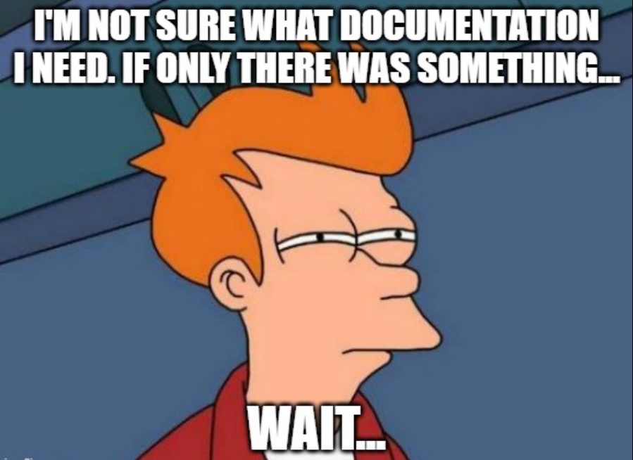
POP QUIZ
Not sure what else you need to upload?

Slide 42
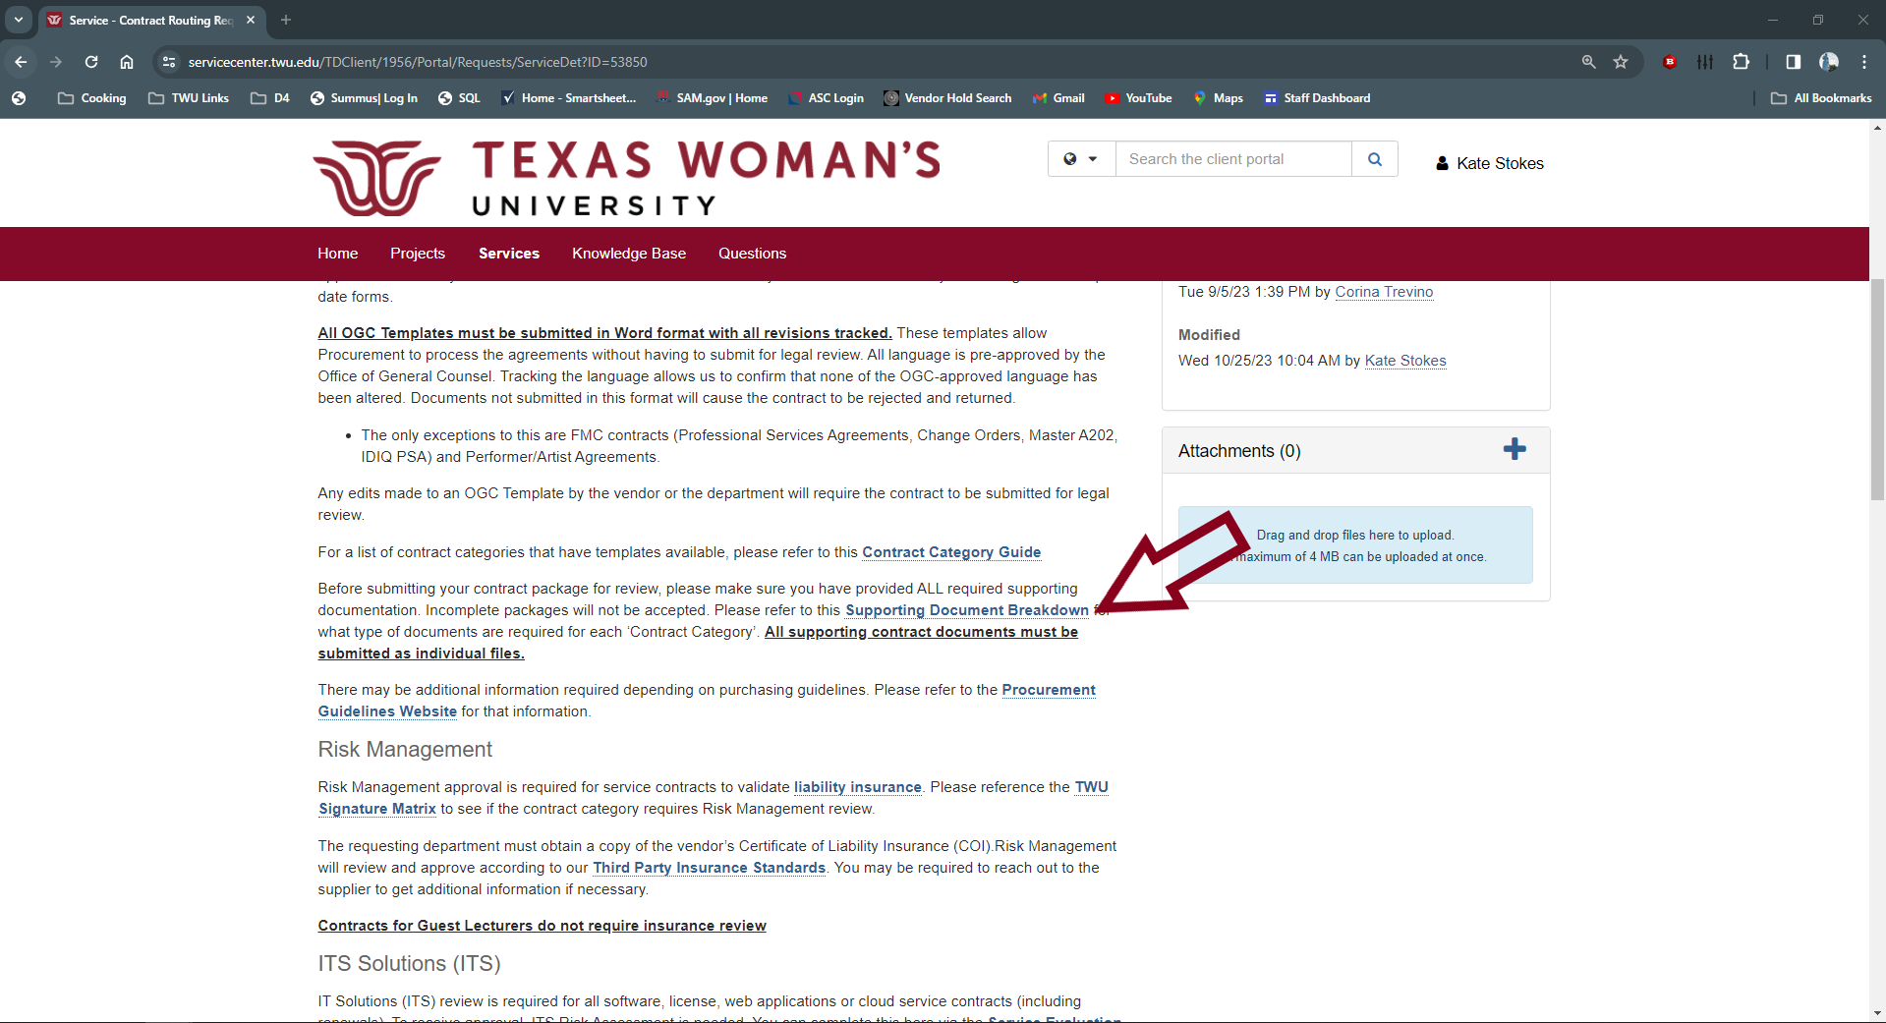
Supporting Documentation Breakdown!
There was! Supporting Documentation Breakdown is located on the landing page.
Notes:
Remember the links on the landing page. Goes to helpful information. One stop shop for contracts. If there's something that would be helpful to add on here, let me know! We’re happy to add more information.

Slide 43
Contracts Crew
Jamie Cogdell – jcogdell@twu.edu
Manager Purchasing & Contracts/Assistant HUB Coordinator
Jenny Keele – jkeele@twu.edu
Coordinator Contract Services
Kate Stokes – Kstokes3@twu.edu
Procurement Generalist/HUB Assistant
Notes:
If you ever have a quick question, I am always available on teams. Hit me up.

