Slide 1
Teaching Summit 2026
Takeaways from Last Year’s
Core Assessment Results
Gray Scott, Ph.D.
Associate Vice Provost for Accreditation
Texas Woman’s University

Slide 2
Core Outcomes Results 2025-26
Overview
General education assessment
Sampled artifacts
Snapshots of student learning
2025-26 Objectives
Empirical & Quantitative Skills
Teamwork
2026-27 Objectives
Personal Responsibility
Social Responsibility

Slide 3
Core Outcomes Results
2025-26
Empirical & Quantitative Skills and
Teamwork
Objective Admissions Basis | Meets Standard |  | Change
 | 2022-23 | 2025-26
Empirical and Quantitative Skills | 80% | 89% | +9%
FTIC | 79% | 90% | +11%
Dual-Credit | 95% | 88% | -7%
Transfer | 80% | 84% | +4%
Teamwork | 87% | 76% | -11%
FTIC | 88% | 78% | -10%
Dual-Credit | 81% | 58% | -23%
Transfer | 87% | 79% | -8%

Slide 4
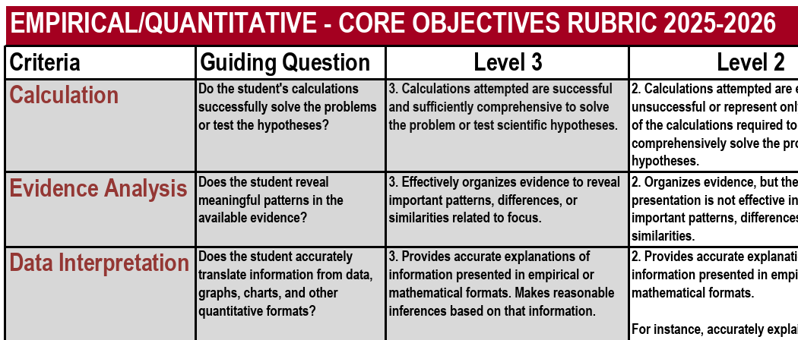
Core Outcomes Results
2025-26
Criteria by Objective

Slide 5
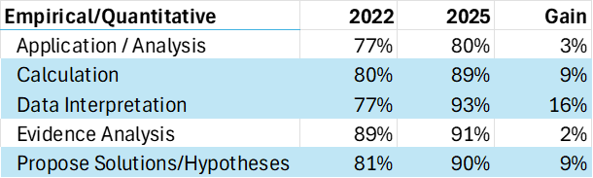
Core Outcomes Results
Drilling Down on EQS
Full-time vs part-time (EQS)
Both gained, but F/T (9%) almost double P/T (4%).
Student classification (EQS)
FR, JR, & SR each grew ~6%, Sophomores improved 11% – while also growing eleven points as a proportion of the studied population (26% to 37%).
By Foundational Area (EQS)
Biology, Chemistry, Math (81%): Improved (6 - 8%)
Psychology & Sociology (12%): Declined (2 - 6%)
By Criterion

Slide 6
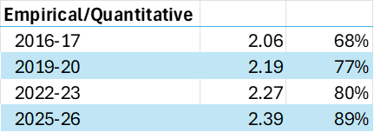
Core Outcomes Results
Drilling Down on EQS
Online Courses
The percentage of EQS students in online classes increased 10 points to 51% while online performance also improved, jumping 77% to 90%.
Interim Changes
November, 2022. Public release of ChatGPT.
November, 2022. “Zero-tuition” program for F/T students eligible for Pell Grants.
A Note on the Pandemic
Readers of the data often ask about Covid.

Slide 7
Core Assessment
Looking Ahead
Objectives this year: Personal Responsibility & Social Responsibility
Personal Responsibility (PR) – to include the ability to connect choices, actions and consequences to ethical decision-making
Social Responsibility (SR) – to include intercultural competence, knowledge of civic responsibility, and the ability to engage effectively in regional, national, and global communities
The above objectives apply to the following FCAs:
First-Year Composition (PR)
Creative Arts (SR)
Language, Philosophy, & Culture (PR, SR)
History (PR, SR)
Political Science (PR, SR)
Social & Behavioral Science (SR)
MWGS (90) (PR, SR)

Slide 8
Core Assessment: Criteria to Consider
PERSONAL RESPONSIBILITY
Research Ethics Suite
  Access and Use Information Ethically and Legally
  Evaluate Information and its Sources Critically
Reflective Suite
  Connect Concepts to Experience
  Reflection and Self-Assessment
  Transfer
Responsible Argument Suite (PR)
  Content Development
  Use of Evidence
  Uses Information Purposefully
SOCIAL RESPONSIBILITY
Responsible Argument Suite (SR)
  Comprehension
  Perspective Taking
  Use Multiple Perspectives in Problem-Solving
Problem-Solving Suite
  Apply Knowledge to Social Issues
  Evaluates Social Impacts of Local Actions
  Understanding Social Systems
  Use Multiple Perspectives in Problem Solving

Slide 9
Core Assessment: Criteria to Be Careful With
PERSONAL RESPONSIBILITY
Weak, Relative to Set
  Application of Ethical Perspectives/Concepts
  Ethical Issue Recognition
  Use of Evidence
Tricky (20% to 53% N/A)
Connect Concepts to Experience
Ethical Self-Awareness
Reflection and Self-Assessment
Transfer
Understanding Different Ethical Perspectives/Concepts
SOCIAL RESPONSIBILITY
Weak, Relative to Set
  Perspective Taking
  Understanding Social Systems
  Use Multiple Perspectives in Problem Solving
Tricky (20% to 57% N/A)
  Asks & Pursues Questions about Cultures
  Comparing Cultures
  Comprehension
  Cultural self-awareness
  Evaluates Social Impacts of Local Actions
  Responsible Action
  Social Identity and Commitment

