Slide 1

Faculty Senate Meeting
Report from the Provost
September 11, 2026

Slide 2
Agenda
Update on census
Next steps for the General Education Review Committee
Three-year degrees
Project Thrive
Come to Believe College

Slide 3
TWU Census Data — Fall 2026
Measure | Fall 2026 | Fall 2025 | Change
Enrollment
Total enrollment | 16,412 | 15,495 | +5.9%
Undergraduate | 10,765 | 9,958 | +8.1%
Graduate | 5,647 | 5,537 | +1.9%
Retention
First-time-in-college (FTIC) | 72.2% | 76.3% | – 4.1 pts
Sophomore | 63.3% | 59.1% | + 4.2 pts
Total enrollment of 16,412 is the highest in university history, as is the 63.3% sophomore retention rate.

Slide 4
Next Steps for the
General Education Review Committee

Slide 5
SB 37: Governing Board Responsibilities for General Education
In reviewing an institution’s general education curriculum, the governing board shall ensure courses in the curriculum:
Are foundational and fundamental to a sound postsecondary education
1
Are necessary to prepare students for civic and professional life
2
Equip students for participation in the workforce and in the betterment of society
3
Ensure a breadth of knowledge in compliance with applicable accreditation standards
4

Slide 6
General Education Review Committee Members
Committee Member | Representation
Brian Fehler | College of Arts and Sciences
Ann Wheeler | College of Arts and Sciences
Joy Spadachene | College of Nursing
Angela Griffin | College of Health Sciences
Ken Boonme | College of Business and Entrepreneurship
Sarah McMahan | College of Professional Education
Nancy Chick | Executive Director of Teaching, Learning and Scholarship
Brandi Falley | Dean of Undergraduate Studies
Cole Kendrick | COO of Medical City, Denton
Anna Meade | Vice President of Sustainability, Toyota
Jill Jester | Attorney, Business Owner, Former Regent
Angela Bauer | Provost and Committee Chair

Slide 7
Current TWU Core Curriculum
Component Area | Credit Hours
Communication | 6
Mathematics | 3
Life & Physical Sciences | 6
Language, Philosophy & Culture | 3
Creative Arts | 3
American History | 6
Government/Political Science | 6
Social & Behavioral Sciences | 3
Component Area Options | 6
Multicultural Women's & Gender Studies | 3
First-Year Seminar, Mathematics, or Wellness | 3
Total | 42

Slide 8
Current discretionary areas within general education
Global Perspectives Course (3 credits)
Course mapping and assessment of THECB-mandated workforce readiness skills (e.g., communication; teamwork; critical thinking)

Slide 9
Recommendation 1: “Women in Society” Course Requirement (CA 90)
Retain the MWGS requirement, retitled “Women in Society,” with a revised description aligned to TWU’s mission, history, and future as a woman-focused institution.
Strong, unequivocal support | Faculty, students, and Committee members — including business and community representatives — endorsed retaining this requirement. No message from the review emerged more clearly.
Mission alignment | The revised component area equips 21st-century students to lead in civic and professional capacities, developing perspective taking, self-efficacy, and engaged citizenship.
THECB Core Objectives | All approved courses will align with Critical Thinking, Communication, Personal Responsibility, and Social Responsibility.

Slide 10
Recommendation 2: Traditional First Year Seminar Requirement (CA 91)
Restructure this component area as a single three-credit UNIV First-Year Seminar, replacing the two credits of Mathematics or Wellness coursework.
Unclear purpose today | All constituencies found the pairing of a one-credit seminar with two credits of Mathematics or Wellness incoherent; the one-credit format dilutes the seminar’s impact.
Evidence-based model | Research on first-year seminars consistently links the three-credit model to stronger student engagement and improved retention.
Implementation underway | Two redesigned versions are being piloted — a faculty “passion topic” course and a professional path and identity course — with more full-time faculty engaged. Quantitative and wellness needs remain met through the Mathematics component area and degree requirements.

Slide 11
Recommendation 3: Eliminate the Global Studies Requirement
Eliminate the Global Studies requirement as a stand-alone element of the general education program (majority support within the Committee; not full consensus).
Weaker constituent support | Survey support for the requirement existed across all constituencies but was notably weaker than the strong endorsement of Component Area 90.
No academic home | No unit owns the requirement’s curriculum, staffing, or continuous improvement.
No assessment evidence | The requirement has gone years without assessment data, leaving the university unable to demonstrate student learning — untenable in the current accountability environment.

Slide 12
Recommendation 4: Revise Approaches to Teaching and Assessing Workforce Readiness Outcomes
Make the teaching of THECB-mandated workforce readiness skills intentional and explicit, and revise assessment to measure students’ growth over time (Committee consensus).
Intentional teaching | Embed career readiness skills — such as critical thinking and teamwork — deliberately into core course design, instruction, and assignments, rather than assuming them as byproducts of content.
Faculty development | Invest in professional development, directly requested by faculty in survey results, to strengthen their ability to teach these skills effectively.
Workplace-relevant assessment | Measure growth in mastery over time and report results in employer-relevant language, so students can articulate their gains and TWU can credibly convey graduates’ career readiness.

Slide 13
Next steps
Call for proposals for Women in Society courses
Call for proposals for UNIV courses:
  UNIV 1233: Passion and Purpose
  UNIV 1333: Profession and Purpose
Recommendations sent to BOR, followed by curriculum approval process
Pulse surveys to get input from component areas re: mapping of workforce readiness skills in core courses

Slide 14
Three-Year Degree Discussion

Slide 15
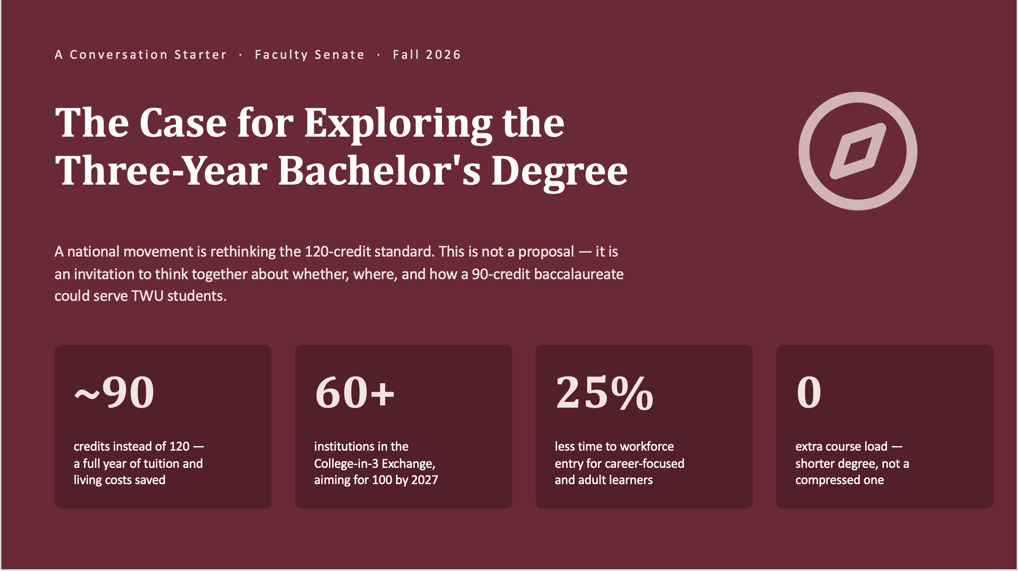
The Case for Exploring the Three-Year Bachelor’s Degree

Slide 16



Who Is Doing This — and What Accreditors Say
The institutional landscape
The accreditation picture
Private pioneers
Historic barrier removed
Johnson & Wales (CS, criminal justice, design, hospitality); BYU-Idaho & Ensign (fully online); Mount Mary (cybersecurity); Manchester, Goucher, Hartwick
Accreditors were long the biggest obstacle. The Higher Learning Commission now permits reduced-credit degrees and has approved 58 programs at 26 institutions.
State systems moving in 2026
Broad regional acceptance
Cal State — approved across all 22 campuses (May); UNC system — initial approval (May); Massachusetts — first pilots (June); Maine — first public system (2025)
NECHE, NWCCU, and WSCUC have approved member programs; Middle States requires no special approval at all.
Common thread
The Texas question
Applied, workforce-facing majors: cybersecurity, business, criminal justice, health administration, public administration, psychology
SACSCOC and THECB approval would be required — and Texas statute currently defines the baccalaureate around 120 hours. Any TWU pathway runs through Austin.
Notes:
Left side: the movement started with small privates but 2026 is the year of state systems — Cal State's all-22-campus approval in May is the biggest signal yet. Note the pattern in subject areas: nearly all are applied, career-entry fields. Nobody is piloting a 90-credit chemistry or pre-med degree. Right side: HLC's shift matters because accreditors were historically the wall this idea hit. For us, the honest caveat is the last card — SACSCOC has not been a first mover here, and Texas would need THECB engagement. Given SB 37's emphasis on efficiency and workforce readiness, this question is likely to reach Texas whether or not we raise it — better for faculty to have thought it through first.

Slide 17


What We Know — and What We'd Need to Answer
Employers: cautiously positive
Graduate programs: the real risk
In a Johnson & Wales survey, most employers viewed a three-year degree as equivalent to a four-year one
Hiring partners consulted by early adopters cared about the credential and major, not the credit count
Honest caveat: few graduates exist yet, so broad acceptance is unproven
In a College-in-3 survey, admissions officers said almost unanimously they would not admit applicants below 120 credits
Most said they are reconsidering as these degrees spread — but today, this is the weak link
Several adopters explicitly steer grad-school-bound students to the 120-credit track
Likely fit: career-entry applied fields; adult learners and career-changers; transfer-heavy populations. Poor fit: graduate-school pipelines, licensure fields with credit-hour rules, and majors where breadth is the point.
FOR DISCUSSION
Is there a TWU program where a 90-credit pathway would serve students well? What would we refuse to cut — and what does that tell us about our curriculum? What evidence would faculty need to see before piloting?
Notes:
Present both evidence columns evenhandedly — the employer picture is encouraging but thin; the graduate-admissions picture is the genuine risk, and states like Massachusetts now require students to sign disclosure forms acknowledging it. The fit/poor-fit band is the honest map: this is not an idea for every program, and no one nationally is treating it that way. Close on the discussion questions and stop talking. The second question — what would we refuse to cut — is deliberately the interesting one: it turns the conversation from a threat assessment into a values conversation about what our curriculum is for. Invite Senate to bring this back to departments and return with reactions rather than votes.

Slide 18
Project Thrive Program Reviews

Slide 19
Project Thrive: Program Viability Criteria
I. Financial Metrics
Course revenue vs. direct instructional cost
Grant and external funding
Faculty reassigned time and administrative load
II. Enrollment and Student Success
Five-year enrollment trend
Two-year success rate (persistence or graduation)
Graduation rate within time-to-degree norms
Five-year semester credit hour production
Five-year cumulative completion rate
III. Regional and State Workforce Demand
Labor market growth or contraction in the field
Consistent external data source year over year
Employer and advisory board feedback
IV. Academic Quality
Accreditation status, where programmatically accredited
Contribution to interdisciplinary programs (qualitative)
V. Viability Review Triggers | Code Yellow — multiple metrics declining; intervention within two semesters. Code Red — immediate risk to sustainability; formal action planning within one semester.

Slide 20
Project Thrive: Fall 2026 Undergraduate Program Review
Every program under review this fall follows the same four-step process:
Orientation — September 25 | Chairs, deans, and Institutional Research meet with the Provost to review the Project Thrive framework and scoring criteria.
1
Data — four weeks before review | Institutional Research delivers the program’s financial, enrollment, retention, and graduation rate metrics, then meets with the chair, dean, and Provost to walk through them.
2
Analysis — three weeks to prepare | The program completes its Project Thrive analysis and submits it to the committee one week before its scheduled review.
3
Review — day of the AABAC meeting | The chair and dean join the committee to discuss its scoring and ask any remaining questions.
4

Slide 21
Undergraduate Programs Under Review — Fall 2026
Program | AABAC Review Date
B.A. in English | Fri, Oct 16
B.A. in Theatre | Fri, Oct 16
B.A./B.S. in Mathematics | Fri, Oct 30
B.S. in Computer Science | Fri, Oct 30
B.S. in Chemistry | Fri, Nov 6
B.S. in Biochemistry | Fri, Nov 6
B.S. in Biology | Fri, Nov 20
B.S. in Medical Laboratory Sciences | Fri, Nov 20
B.A.S./B.S. in Health Studies | Fri, Dec 4
B.S. in Kinesiology | Fri, Dec 4

Slide 22
Come to Believe College

Slide 23
The pathways are real
advance placement
dual credit
P-TECHs
early college high schools
collegiate high schools
community college transfers
direct admit

Slide 24
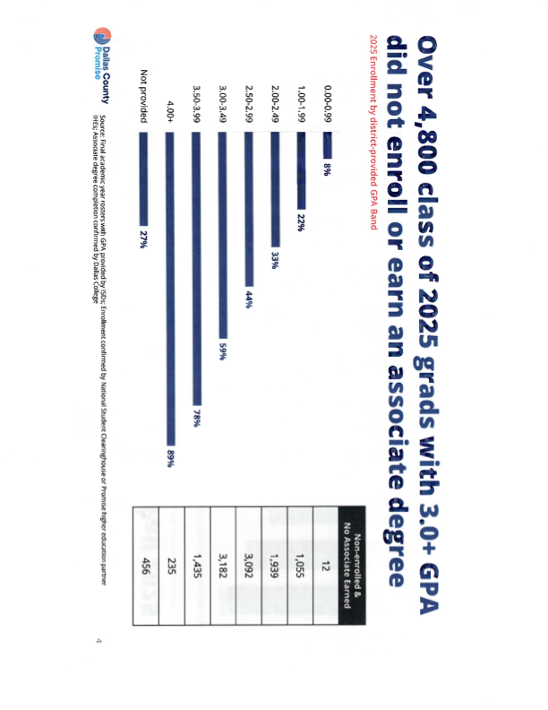
And still, too many students go nowhere
For 2025:
7,944 with
GPA ≥ 2.5
went
NOWHERE
Notes:
If we enroll just 150, our goal, that is less than 2% of those who went nowhere

Slide 25
The barrier is not ambition
family income earner
caregiver
distrust
transportation
opportunity cost
fear of starting and not finishing

Slide 26
A new pathway
The Downtown
TWU Dallas
Two Step
Step 1: Associate degree, credential of value
Step 2: Bachelor of Business Administration at TWU Dallas

Slide 27
Why this model
3 - 5x
two-year completion compared to national average
80%
matriculate to step 2, the bachelor’s degree
90%
complete the bachelor’s degree
debt-free

Slide 28

Questions?

