Slide 1
Purchasing Training
Notes:
Introductions to anyone with procurement services – name and title.

Slide 2
What is Procurement Services?
Procurement means the process of purchasing goods or services.
All purchases and contracts are reviewed and approved in the Procurement and Contract Services (PCS) department.

Slide 3
Procurement Process Overview
DEPARTMENT
DEPARTMENT
DEPARTMENT
Creates requisition with selected vendor
Account manager approves requisition
PURCHASING
Determines need, obtains quote(s)
Reviews requisition for compliance
PURCHASING
PURCHASING
PURCHASING
Creates purchase order (PO)
Approves purchase order
Emails PO to supplier (vendor)
SUPPLIER
SUPPLIER
DEPARTMENT
Submits invoice to Accounts Payable (A/P) with PO number
ACCOUNTS PAYABLE
Delivers goods/services
Receives Oracle Cloud
Pays invoice

Slide 4
Requisition
VS
Purchase Order
Requisition = Department Request
Purchase Order (PO) = Purchasing
TWU contract & commitment-to-pay between the University and Supplier
A “request” for goods or services initiated by the department & processed through Oracle Cloud.
PCS reviews the requisition, then converts to a PO
Departments enter requisitions based on quotes.
PCS emails the PO to the supplier

Slide 5
Requisition VS. Purchase Order
Important Notes:
Services should not begin, & goods should not be ordered until an approved PO has been issued by PCS and received by the supplier.
A “Confirming Order” is when goods and services are ordered prior to a PO being processed
This violates TWU and State policies, and TWU is not obligated to pay
If
Then
PO
Supplier

Slide 6
What is a Purchase Order?
Answer: A Purchase Order is the TWU contract and commitment to pay between the University and Supplier

Slide 7
2. Who enters a requisition?
Answer: The Department

Slide 8
3. When someone places an order over the phone and is sent an invoice and enters a requisition to get the supplier paid what is this called?
Answer: Non-Conforming Order

Slide 9
Procurement Limits
OPEN MARKET
INFORMAL BID
FORMAL
BID
$0 - $20,000
$20,001 - $40,000
$40,001 and up
Formal Solicitation Request from Dept
PCS formally bids service/good
Can take up to 6 months
1 Quote
Use any supplier
3 Quotes
2 HUB Vendors

Slide 10
Informal Bids
Important Notes:
Department contacts vendors for pricing
“No Bid” = Not Accepted
Keep going until you get 3 quotes with pricing
Must include
2 HUB
Quotes
How to Search for HUB Vendors:
https://twu.edu/procurement/purchasing/
What IS a HUB?

Slide 11
HUBs
HUB stands for Historically Underutilized Business.
To become a HUB, a business must be:
A Small Business
At least 51% owned by a(n):
American Woman
Asian Pacific American
Black American
Hispanic American
Native American
Service-Disabled Veteran
Based in Texas
A business that meets these criteria can apply for HUB certification
Notes:
What are HUBs?

Slide 12
HUBs
Historically Underutilized Businesses
Contract Category | % Spent with HUBs
Heavy Construction (other than building contracts) | 11.2%
All Building Construction | 21.1%
All Special Trade Construction | 32.9%
Professional Services | 23.7%
All Other Services | 26%
Commodities | 21.1%
By law, every state agency and university must aim to meet these HUB Goals.

Slide 13
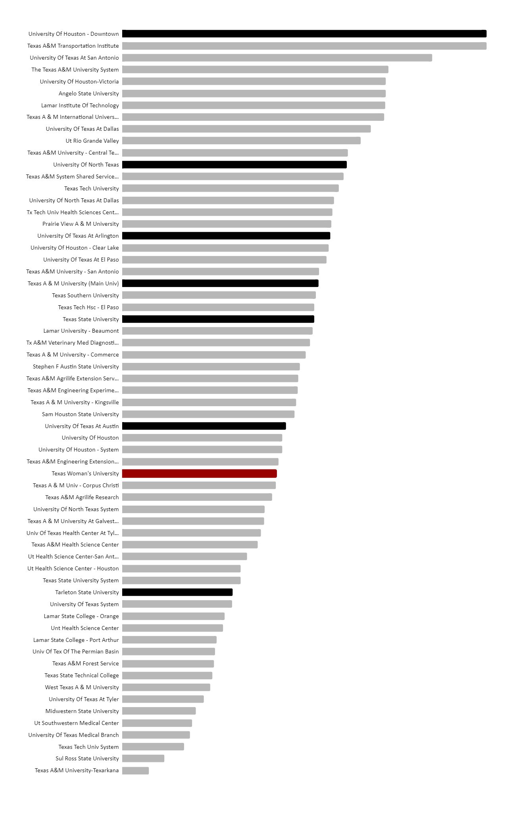
HUBs
Historically Underutilized Businesses
So, how do we stack up?
In 2023 TWU ranked at #38 out of 63 Texas Universities for % expenditures with HUBs.
How can we do better this year?
#1
UHD
#12
UNT
#18
UTA
#22
TAMU
#25
TXST
#34
UT
#38
TWU
#48
Tarleton

Slide 14
HUBs
Historically Underutilized Businesses
This is the BIGGEST HUB event in Texas, and our best shot at finding amazing HUB vendors.
The
Spot Bid
Fair!
We need your bids by May 1st!
Not sure what to bid for? Here are some actual bids from previous years:
1 dry erase marker
$1.41
6 rolls medical tape
$60.90
8ft fiber-glass ladder
$207.00
32 custom women’s polo shirts
$1,065.28
HVAC cooling tower maintenance
$100,000.00

Slide 15
HUBs
Historically Underutilized Businesses
Mark your calendars!
Meet our HUB Vendors!
Eat free food!
TWU HUB Fair
June 5, 2024
10am – 1pm
See cool research equipment up close!
Get free stuff!

Slide 16
State Cooperative Contracts
Suppliers on these contracts have already been competitively bid and awarded = Satisfies the bidding requirements
PRE-APPROVED
Quote MUST reference cooperative agreement number
TWU are members of MANY Cooperative Contracts:
https://twu.edu/procurement/purchasing/cooperative-purchasing/

Slide 17
Sole Source
When only one source is available for the good/service requested or when only one product will meet your needs.
A Sole Source Justification form must be completed and signed by Account Approver; approved by Procurement.
Examples:
Medical equipment made by the manufacturer. There are no resellers.
Not a sole source – HP computer. Only made by HP but is distributed by many different resellers.

Slide 18
What are informal bid limits?
Answer: $20,001 - $40,000

Slide 19
2. If I have ordered $18,500 from Supplier A and I have a new quote for $10,500 total in the same Fiscal Year do I need to obtain more quotes?
Answer: Yes, you are now over Open Market limit for this FY

Slide 20
3. What is the benefit of using a supplier on a cooperative contract such as E&I or TIPS?
Answer: It satisfies the bid requirements.

Slide 21
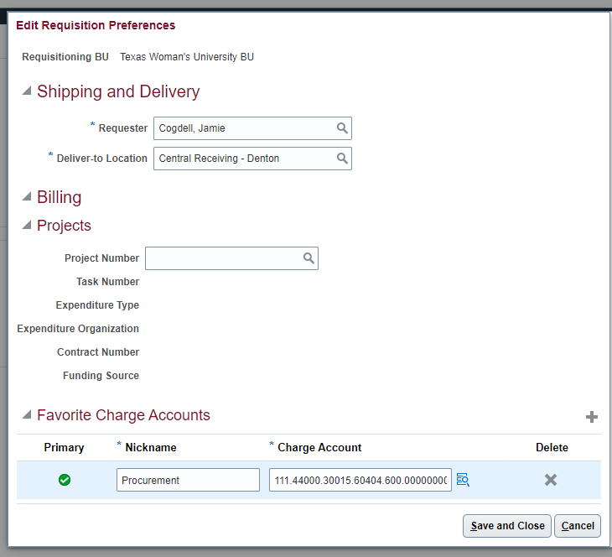
Oracle Cloud = WHAT’s NEW?
Set Preferences
Procurement-Purchase Requisitions-
More Tasks – Update Requisition Preferences

Slide 22
Oracle Cloud = WHAT’s NEW?
Supplier Self-Registration
Suppliers can now:
Register online (no more forms being emailed)
Create a portal account
Make changes to their account
View POs and invoices
You can send this link to the supplier: Oracle Cloud Supplier Registration Link

Slide 23
Oracle Cloud = WHAT’s NEW?
Line Type
Only select for line: “Goods billed by QUANTITY or Services billed by QUANTITY”

Slide 24
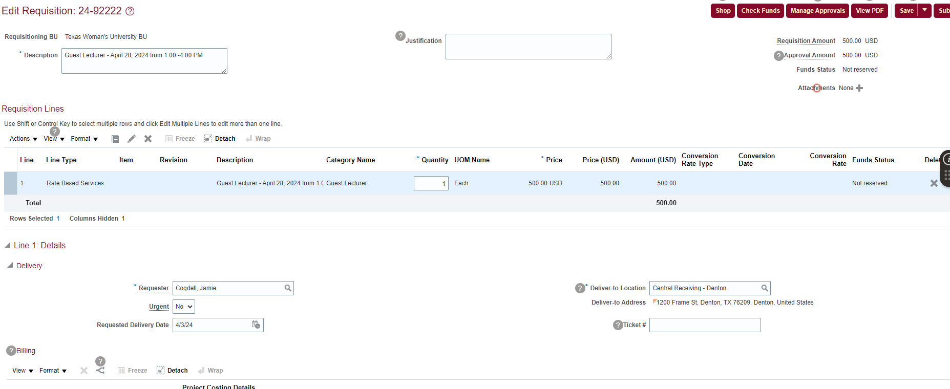
Oracle Cloud = WHAT’s NEW?
Deliver to Location: Ship-to (header) & Deliver-to (on line) locations must match = Central Receiving

Slide 25
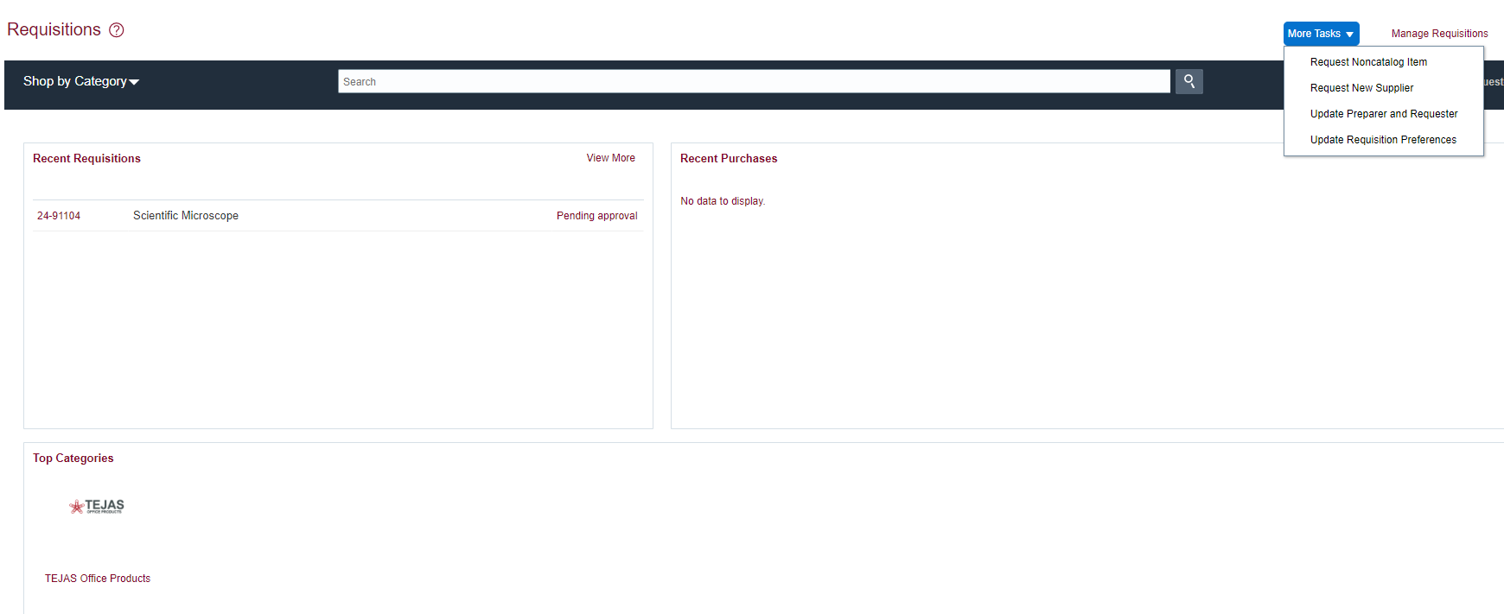
Oracle Cloud = WHAT’s NEW?
Creating a Requisition
Non-Catalog Request
Notes:
Purchase Requisitions – More Tasks

Slide 26
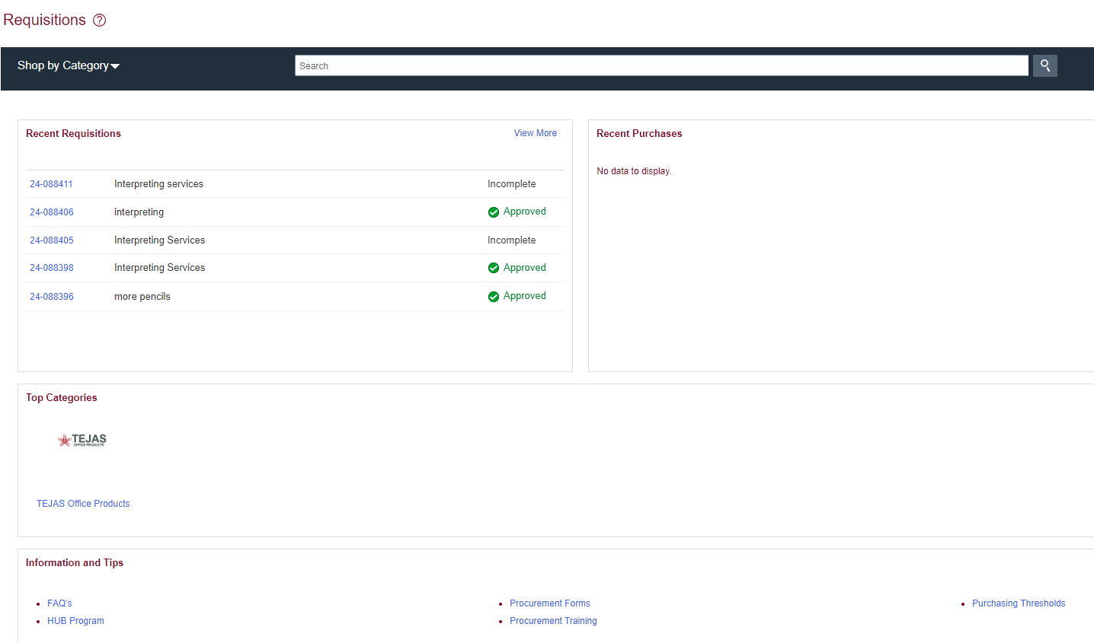
Oracle Cloud = WHAT’s NEW?
Creating a Requisition
Tejas Catalog Request
Notes:
Purchase Requisitions – Tejas Office Products

Slide 27
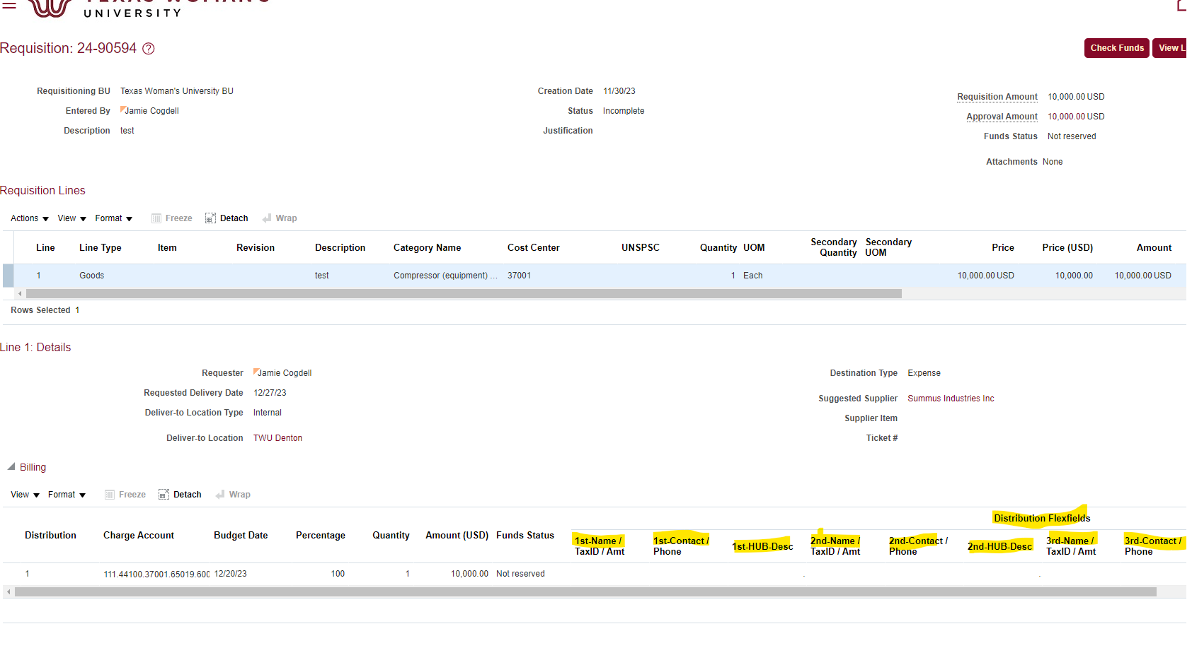
Oracle Cloud = WHAT’s NEW?
Informal Bids
Dept enters all supplier information obtained on quotes on distribution line
Notes:
Must have winning bid referenced in 1st name distribution line – this is what is new….that is where we pull info for state reporting

Slide 28
Oracle Cloud = WHAT’s NEW?
Receiving
Complete ALL information with arrow:
Notes:
Requester / Items Due: ANYTIME / BU: TWU and Purchase Order number – FULL NUMBER TWU24-XXXXXX

Slide 29
Common Rejections in Cloud
Central Receiving not selected as ship-to AND deliver-to
Category Name selected not correct
Quote expired/Amounts don’t match
Service dates have passed
Contract is needed/Quote requires signature
no documentation attached stating vendor will accept PO in lieu of signature
Requisition line type selected incorrect
Do NOT choose line type: Services Billed by Amount
Missing Documentation: RA, Quote, Food Justification Form
Notes:
Find line type name that is wrong

Slide 30
Purchasing FAQ’s
If there are 2 different approvers (split purchase) will both be notified to approve? YES
I am trying to select my category and it keeps changing back to what I set in my preference? You must select the category name – you can’t just type the 6-digit number into chartstring
What shipping locations should I use? Central Receiving – Denton, Central Receiving-Dallas or Central Receiving-Houston
How long will it take for my requisition to be processed to a PO? Once purchasing receives a fully approved requisition with ALL required documentation buyers have 5 business days to review and convert to PO.

Slide 31
Purchasing FAQ’s continued…
5. I have a RUSH requisition I need converted in a hurry. What is the procedure? There may be unavoidable circumstances where a requisition would need to be converted quickly – please email procure@twu.edu with the requisition number and Rush reason
6. How do I process a change to an existing PO? POCN’s (Purchase Order Change Notice) are processed the same way as before – a new requisition is entered with the change and in description add “POCN to POXXXXX” so we know which PO it needs to be added too.
7. How do I look up an existing PO or Requisition in Cloud? Purchase Requisitions – Manage Requisitions
Notes:
If EBS PO you won’t be able to see it.

Slide 32
8. Why can’t I view my requisition from the old system in Cloud?
Answer: None of the requisitions came over from EBS into Cloud – only OPEN POs with funds available

Slide 33
Contact Information
Contracts: twucontracts@twu.edu
Supplier: twusupplier@twu.edu
Purchasing: procure@twu.edu
Credit card: ccservices@twu.edu
Payments/Invoices: twupayables@twu.edu
Procurement Training Calendar: https://twu.edu/procurement/training-and-resources/
Notes:
Check out our procurement training calendar on website – for future trainings in contracts, purchasing and pcard

